Slide 1

ExcelR Group Project
Customer Personality Analysis

Slide 2

Team Members -
PRADNYAN MANOHAR THAKARE
SHIVANSH DIYODHAR
FARDIN AINUDDIN LADKHAN
GUDELLI MAHESH

Slide 3
What is Customer Segmentation??
Customer Segmentation Analysis helps Businesses to modify it’s products based on it’s target customers from different types of customer segments.
For example, instead of spending money for marketing a new product to every customer in company’s database, a company can analyze which customer segment is most likely to buy that product and then market a product only to that particular category or segment of customer first and then accordingly.
This analysis can be helpful for a company to attract more customers and can make huge profits from them.

Slide 4

Project Overview -
Analyze the provided customer’s historical data to know the customer’s behaviour, so that provide better service and offers to the customers.
Understand customer’s behaviour to target right customers for increasing sales and attract more customers by providing exciting offers to make profits.
Collect the insights from historical data and make cluster prediction model to make it easier for companies to make their decisions.

Slide 5
Project Milestones -
Exploratory Data Analysis
Model Building
Model Evaluation
Model Deployment

Slide 6
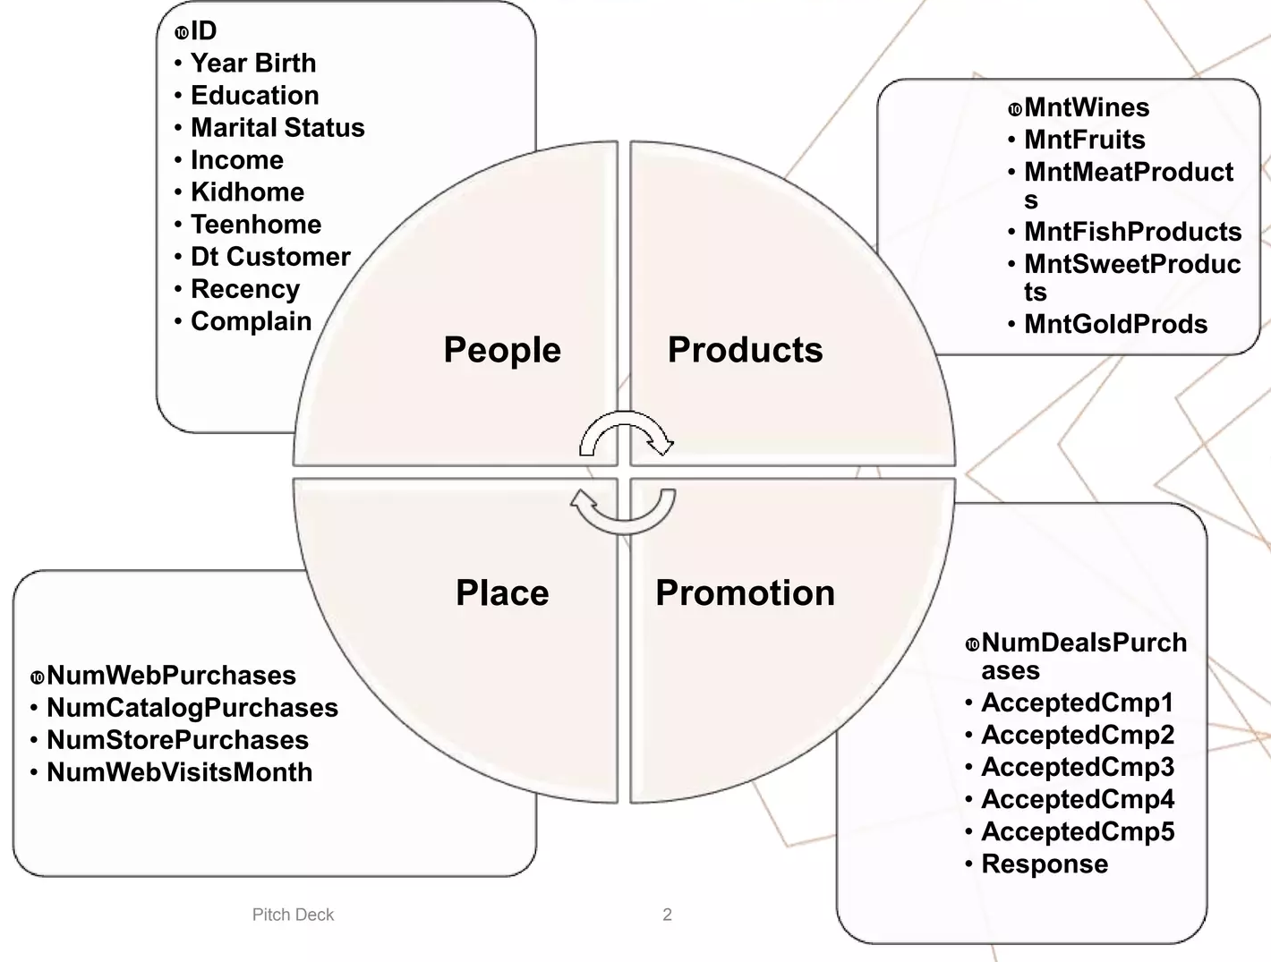
Dataset Attributes -
Exploratory Data Analysis -

Slide 7
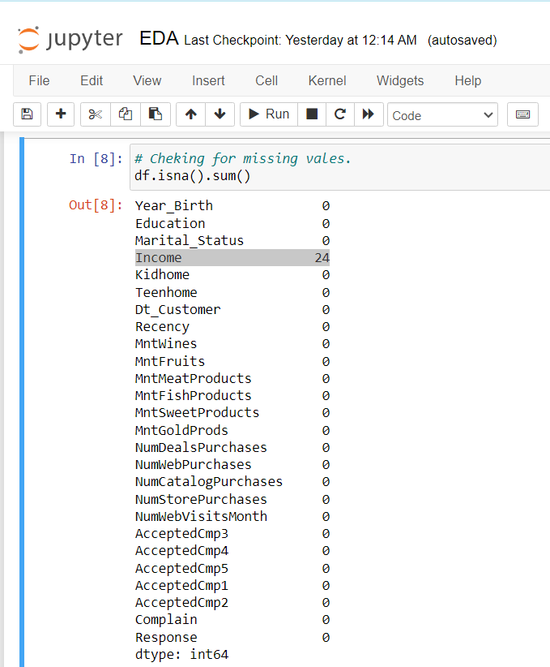
Missing Values -
(Data Cleaning & Preprocessing)
None of the columns except “Income” is having missing values.
There were 24 missing values in “Income” column.
Only 1.07% values from column “Income” was missing, So as per the rules, we dropped entire records with missing values using
df.dropna(inplace=True)

Slide 8
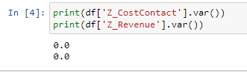
Dropping unnecessary Columns -
Dropped “Z_CostContact” and “Z_Revenue” columns from dataframe.
When calculated the Variance and Standard Deviation of these columns it came out to be 0(zero).
As the variance is 0, These columns does not represent any information related, so dropping them could be the best choice.

Slide 9
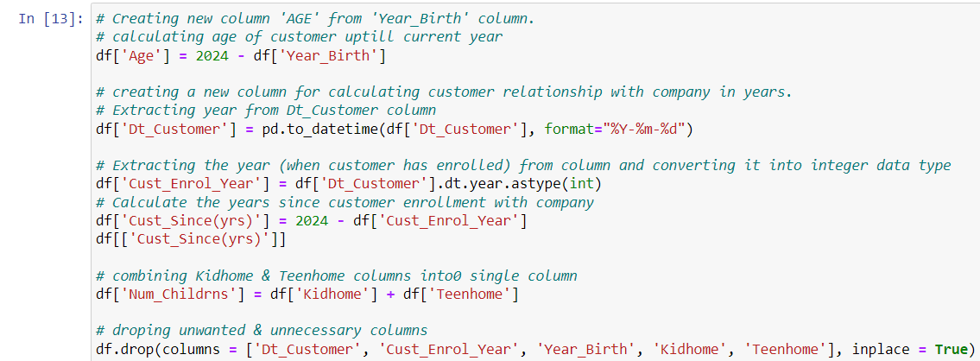
Creating New features from existing -
Calculating “Age” of customer until current year from “Year_Birth”.
Extracting only Year of enrollment from “Dt_Customer”, to calculate the years of relationship with customer.
Created new feature “Num_Childrns” to reduce the dimension of dataframe by summing “Kidhome” and “Teenhome”.

Slide 10
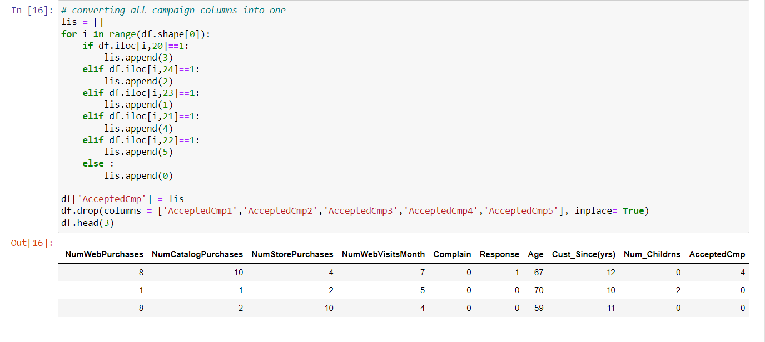
Converting Multiple Columns Into one -
Converted 'AcceptedCmp1',' AcceptedCmp2',' AcceptedCmp3',' AcceptedCmp4',' AcceptedCmp5' to single column using for loop for reducing the higher dimensionality of dataset.

Slide 11
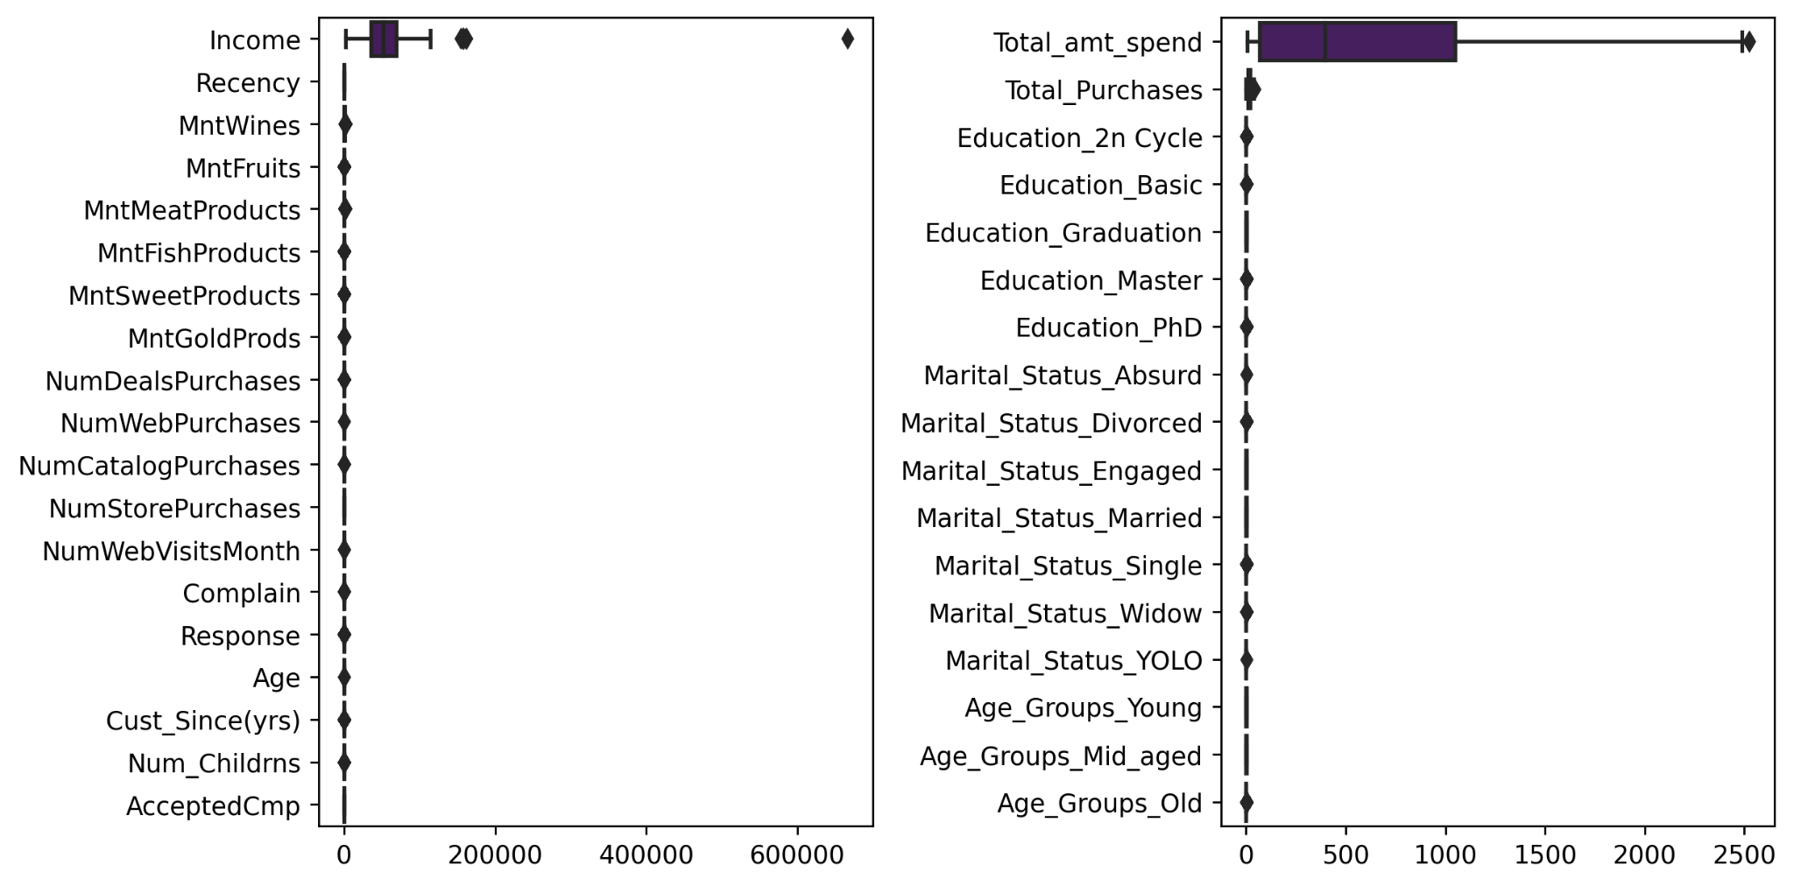
Outliers Detection -
Detected outliers data points by plotting the boxplots of all columns, which was affecting the data distribution and was the reason for skewness in data distribution.

Slide 12
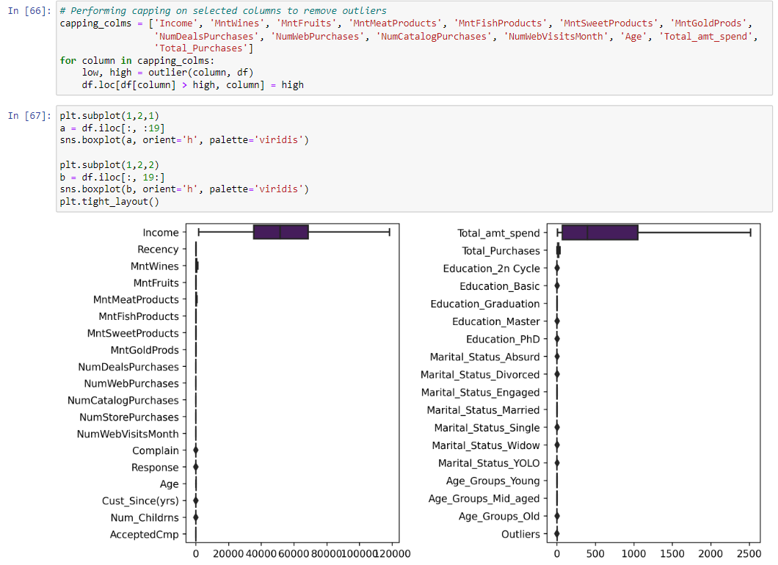
Treating Outliers -
Applied Capping Method on selected attributes to remove outliers from data.
Replaced Anything above or below the cap gets set to the capped min or max respectively.
Capping helped to make data distributions normal.

Slide 13
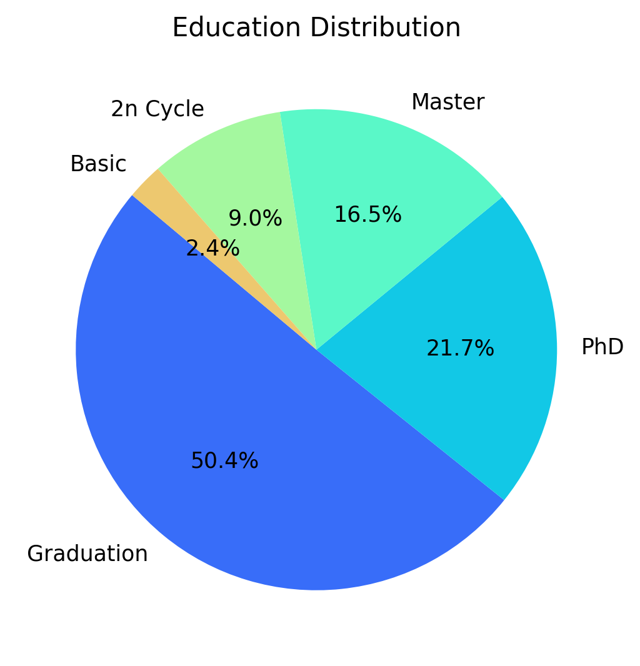
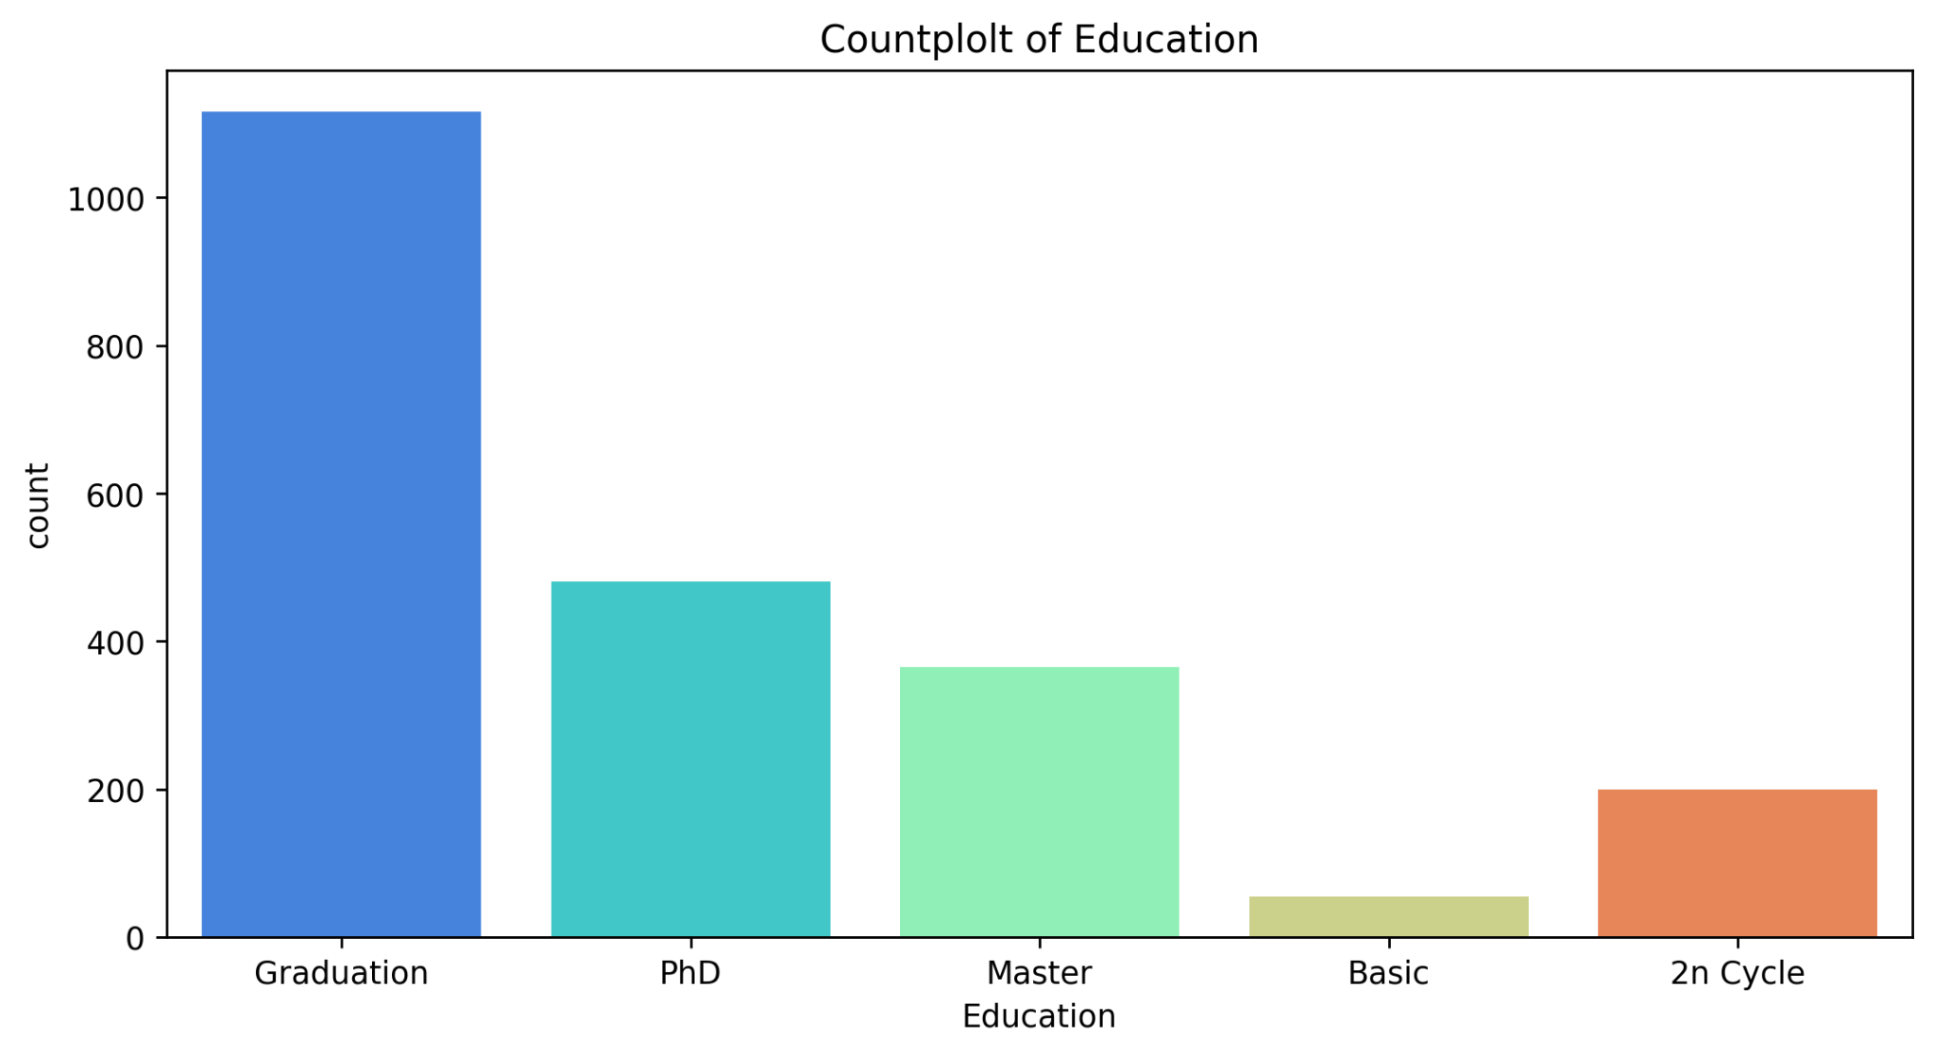
Data Visualizations -
By plotting the countplot of ‘Education’ column we found that -
Around 50% of customers are Graduated.
More than 37% of customers have done post graduation
Only 9% of customers have gone for 2n Cycle.
Over 21% of customers have done PhD

Slide 14
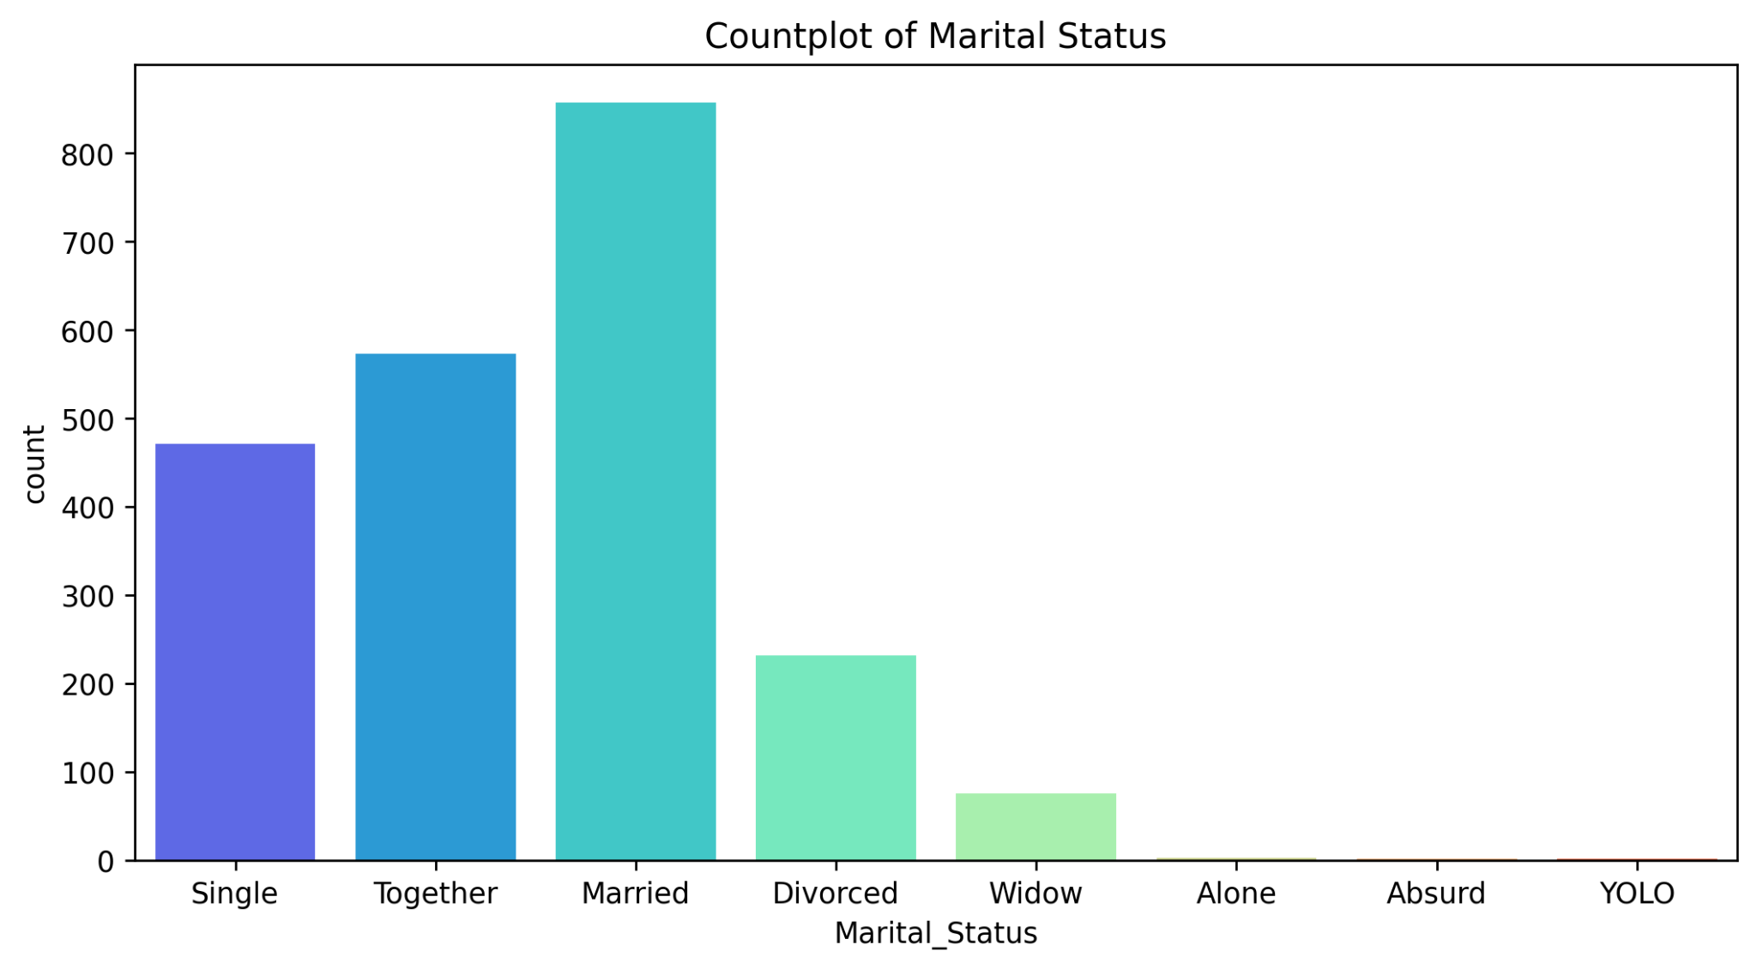
This plot shows the martial status of company’s customers -
Majority of customers are Married and Living Together(Engaged).
Almost 500 customers are single it means they are not married yet.
Around 25% of customers are Divorced, and near to 10% of customers are Widow.

Slide 15
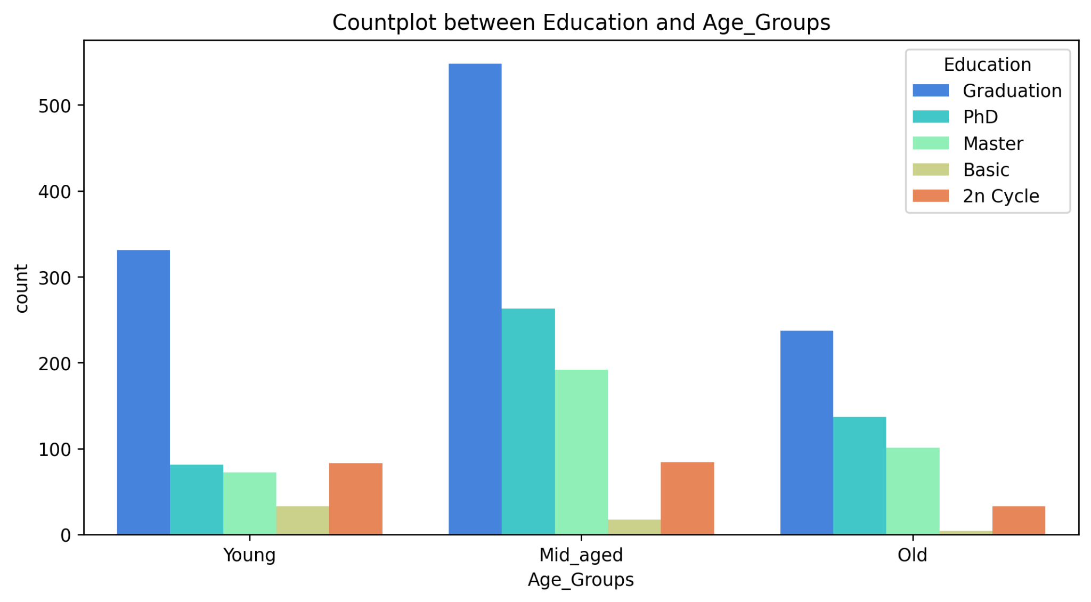
Countplot Between Education and Age Groups -
By plotting this plot it looks like -
There is a fix pattern following between all age category of customers.
In every age category, most of the customers are Graduated and done their PhD.
Very less number of customers from Old age group have done their basic education as compared.

Slide 16
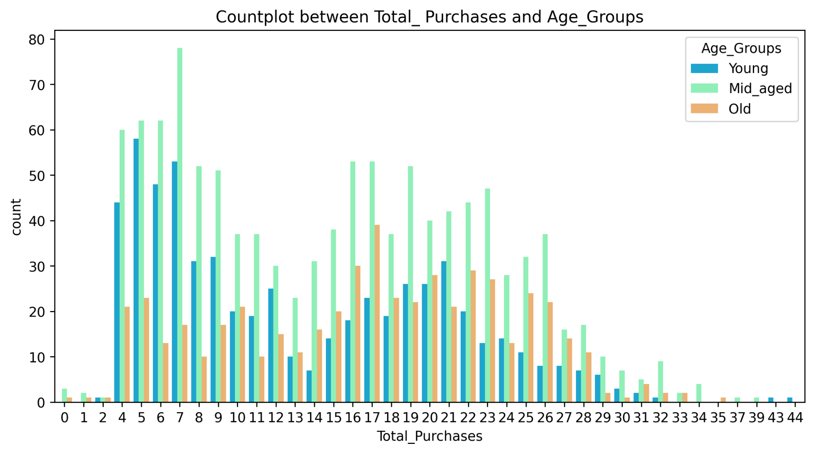
Understanding Total Spend with Age Groups -
We found that -
Customers between age 47 - 65 are purchasing more products as compared to others.
Most of the purchases are done by Mid Aged customers.
There are very less purchases more than 29.

Slide 17
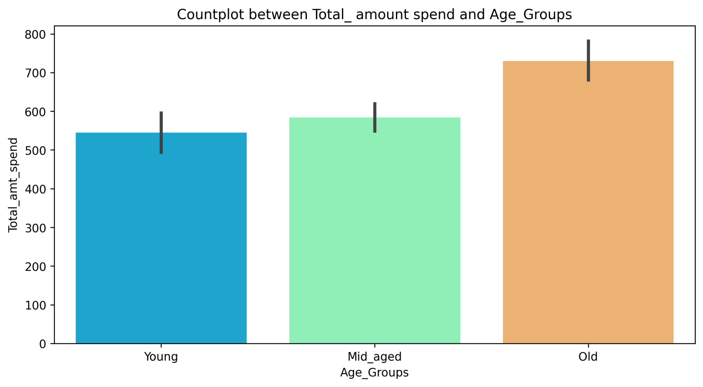
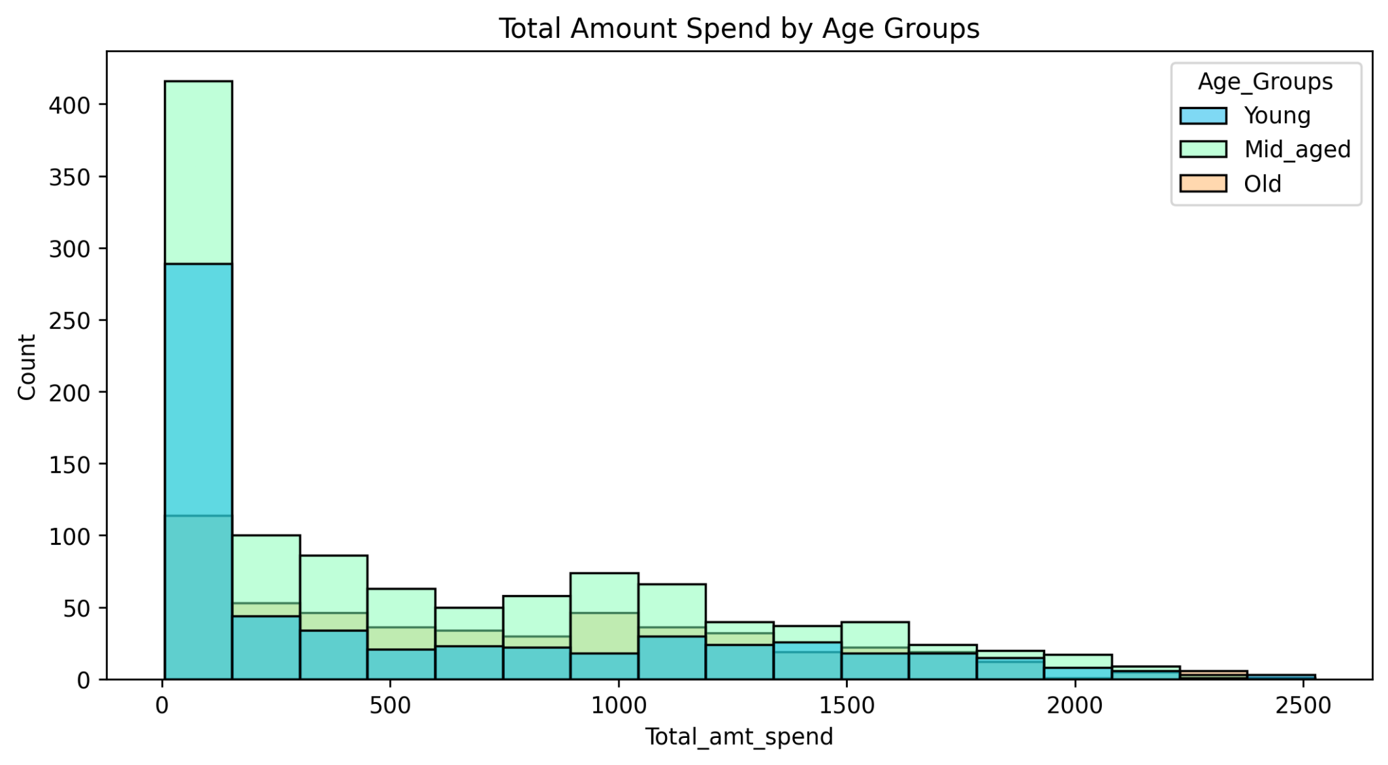
Who is spending more Money??
When analyzed the Total Amount Spending we found -
Customers from Old age group (age > 65) are spending more money for purchasing products.
It means customers from Mid Age group are purchasing products but Old Aged customers are paying more than Mid Aged.
Either Old Aged customers are buying expensive products as compared to other.

Slide 18
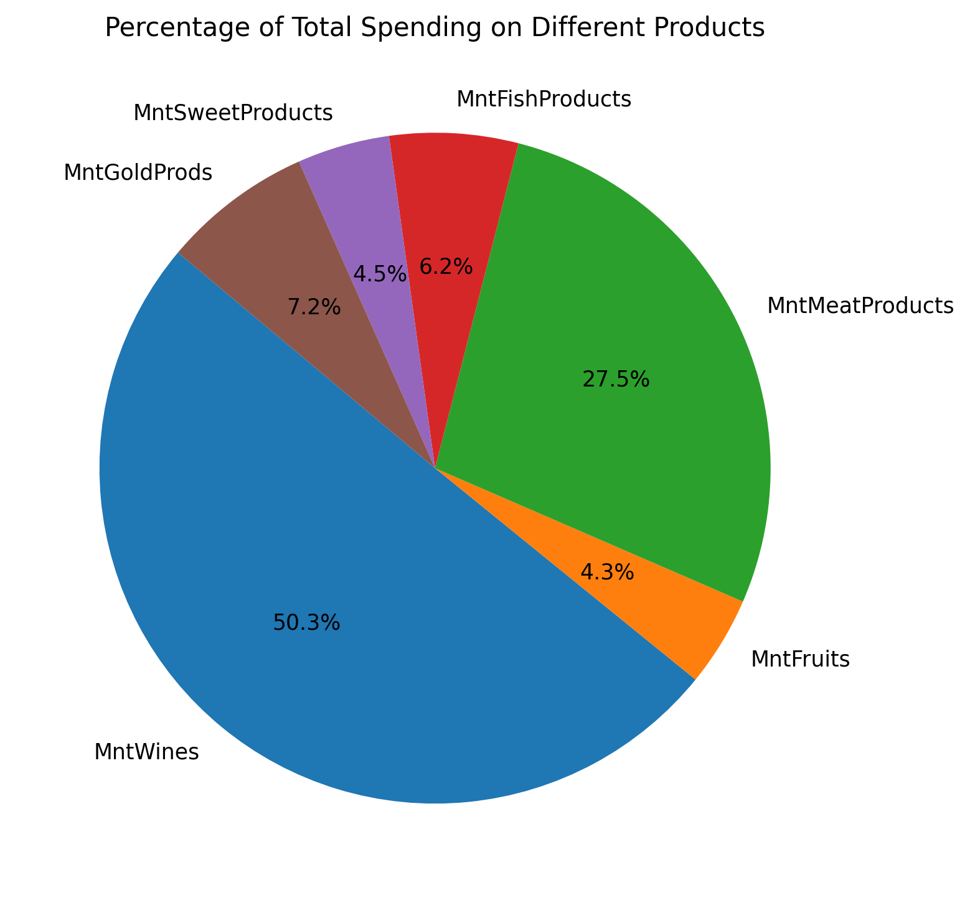
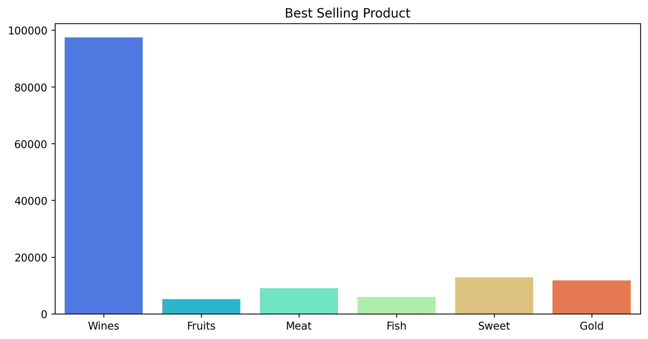
Visualizing Most demanding product -
Over 50% of customers are purchasing Wines.
27 % customers are interested to buy Meat products.
7.2% people are investing their money on Gold products.

Slide 19
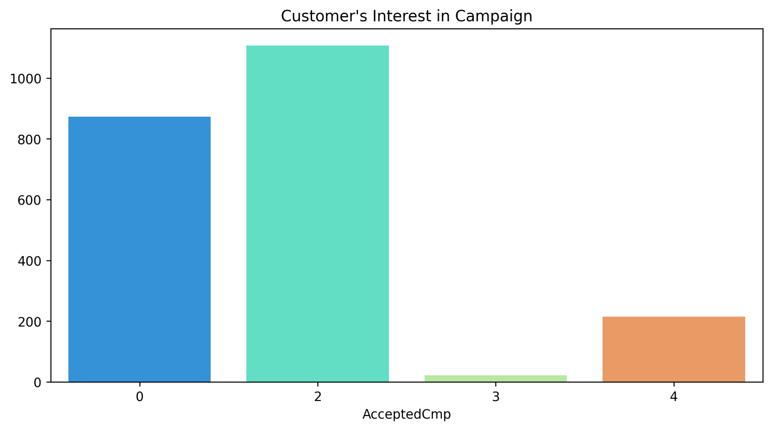
Customer’s behaviour with campaigns -
By analyzing the customers behaviour and interests towards campaigns we found -
Lot’s of customers are not interested to make purchases through campaigns. (0 shows the no. of customers not interested in campaigns)
Campaign 2 was the most successful campaign and accepted by majority of customers.
Company should focus on creating campaigns like campaign 2 for attracting more customers.

Slide 20
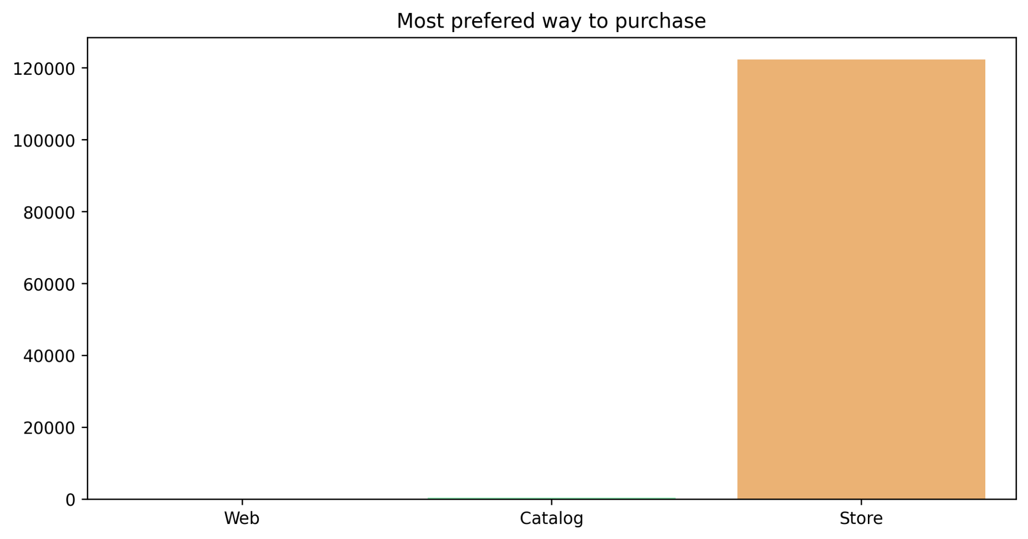
Most Prefered way to make Purchases -
Customers prefer to make purchases through store as compared to web or catalog purchases.

Slide 21
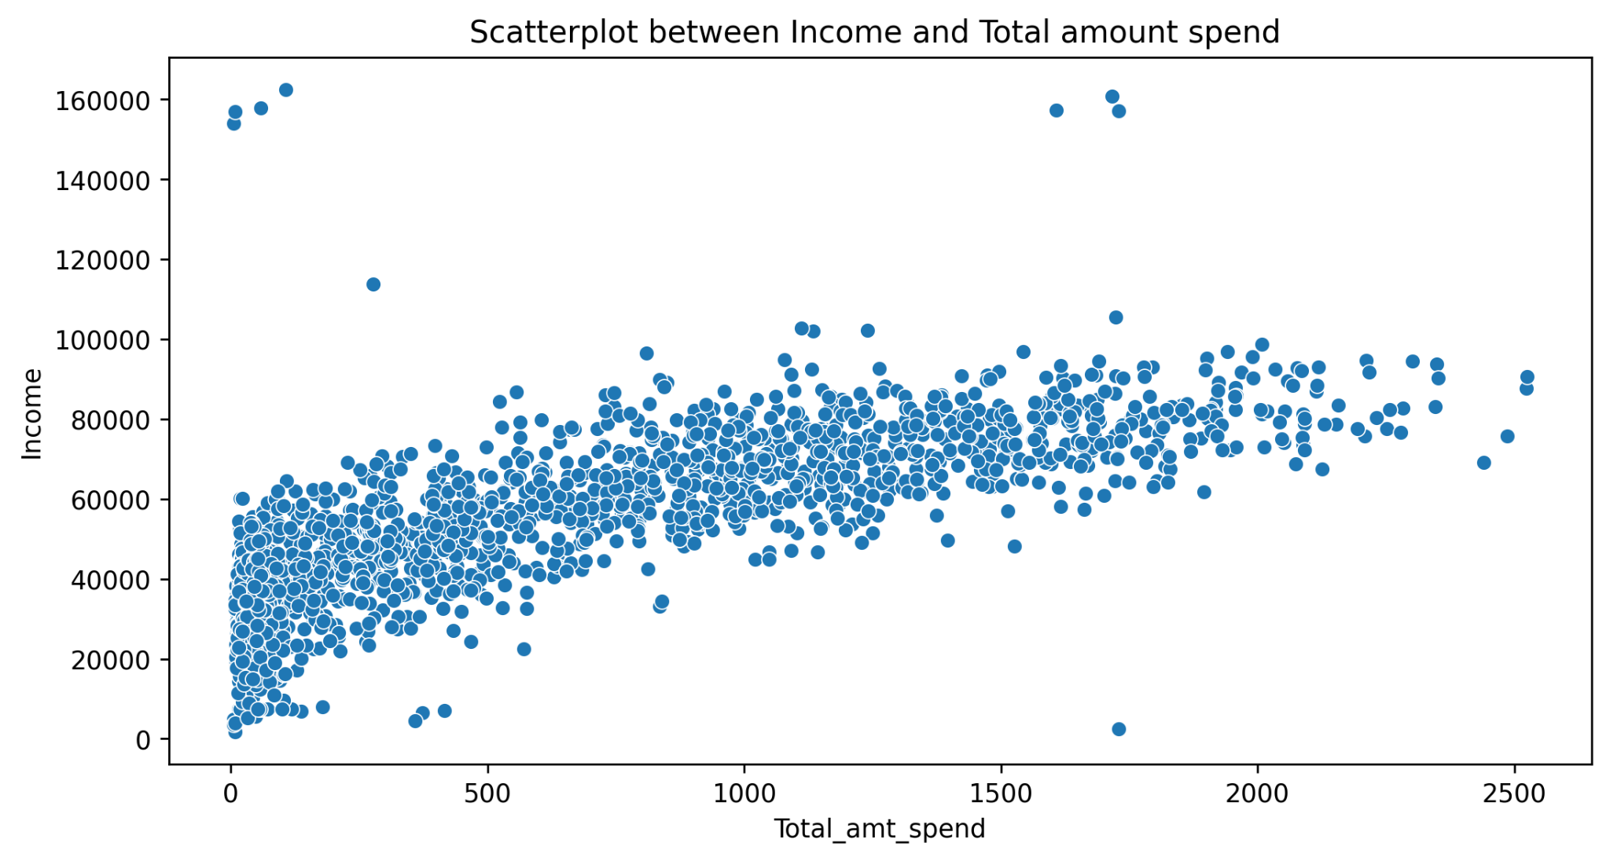
Understanding relation of Income and Amount Spending by customer -
There is increasing trend seen between Income of customer and Total Amount he is Spending.
As the income of customer is increasing the amount he spends also slightly increasing.

Slide 22
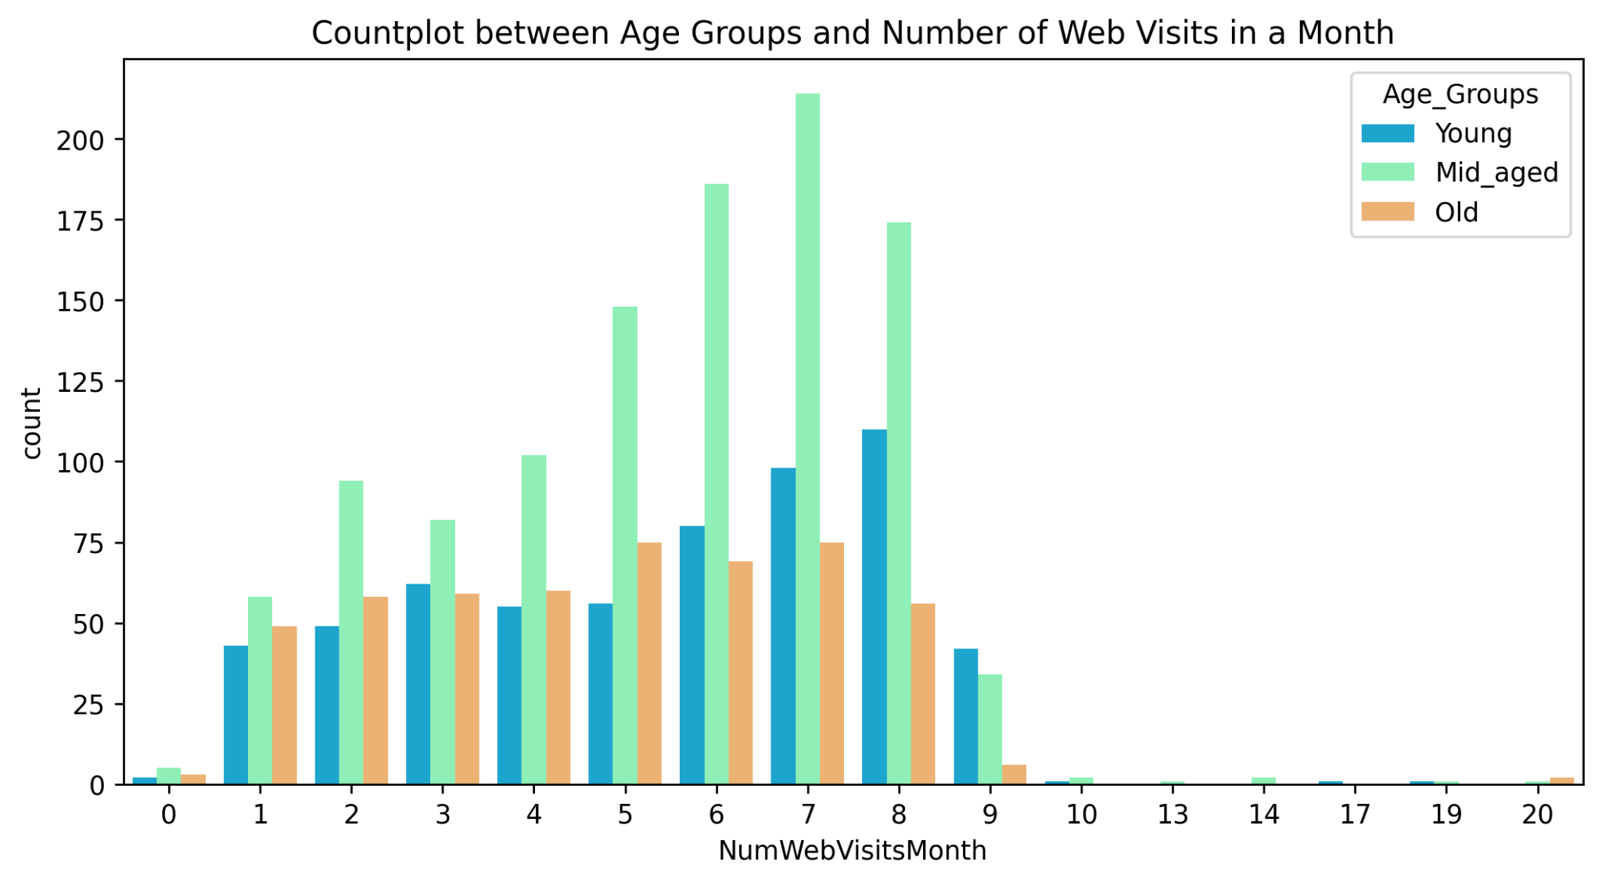
Number of Website Visits by Age Groups -
We found that customers of Mid Age Group are visiting the company’s website the most.
Young Aged customer are visiting the website frequently.
But the customers of Old Age Group is not visiting website they believes to make purchases through stores only.

Slide 23
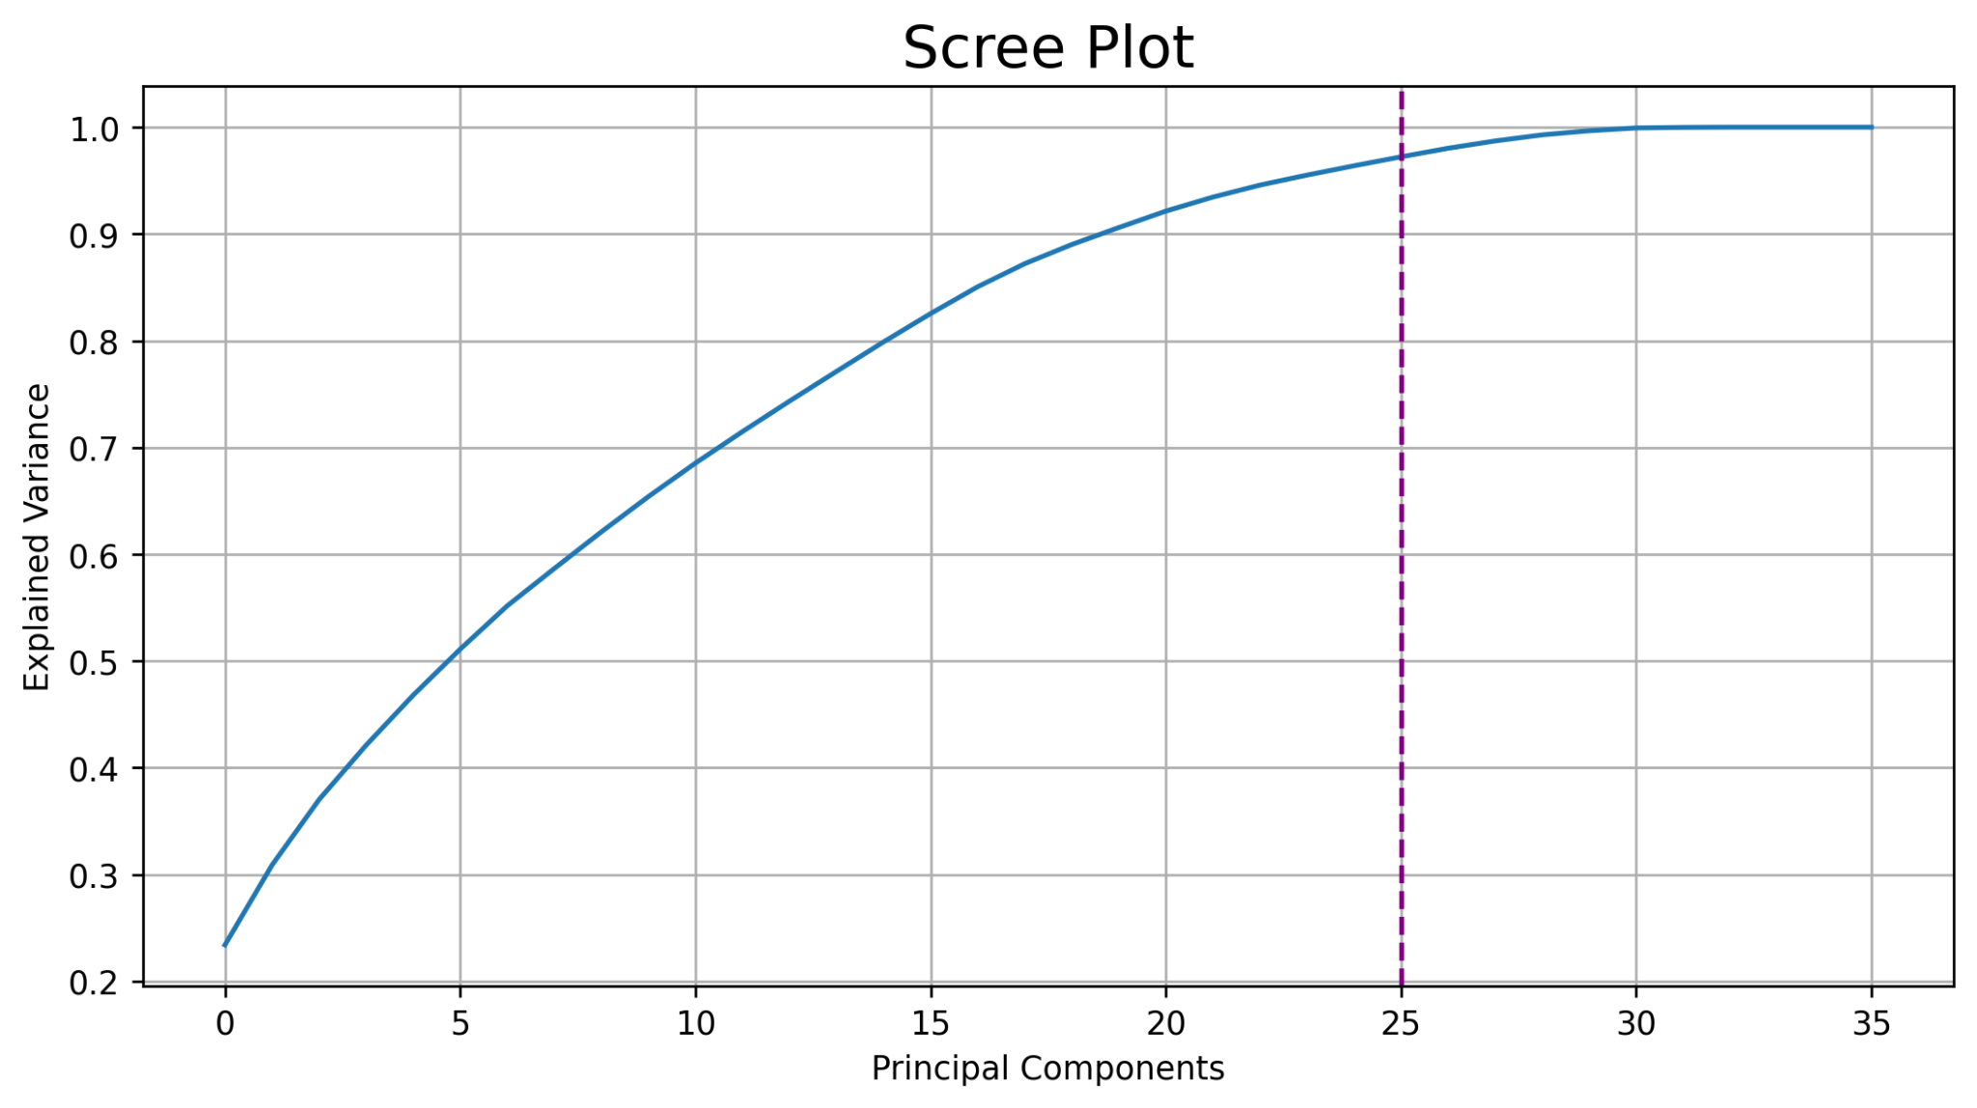
Dimensionality Reduction of Data -
Applied Black Box Algorithm (PCA) to convert higher dimension data into lower without any loss of information.
Reduced dimensions of data from 37 to 25 by covering more than 95% of information.
It can help to create predictive models with less computational power and memory issues.

Slide 24
Clustering Model Building -
Algorithm 5
DBSCAN
Algorithm 1
Hierarchical Clustering (Single Linkage Method)
Algorithms Used -
Algorithm 4
K-Means Clustering
Algorithm 2
Hierarchical Clustering (Complete Linkage Method)
Algorithm 3
Agglomerative Clustering

Slide 25
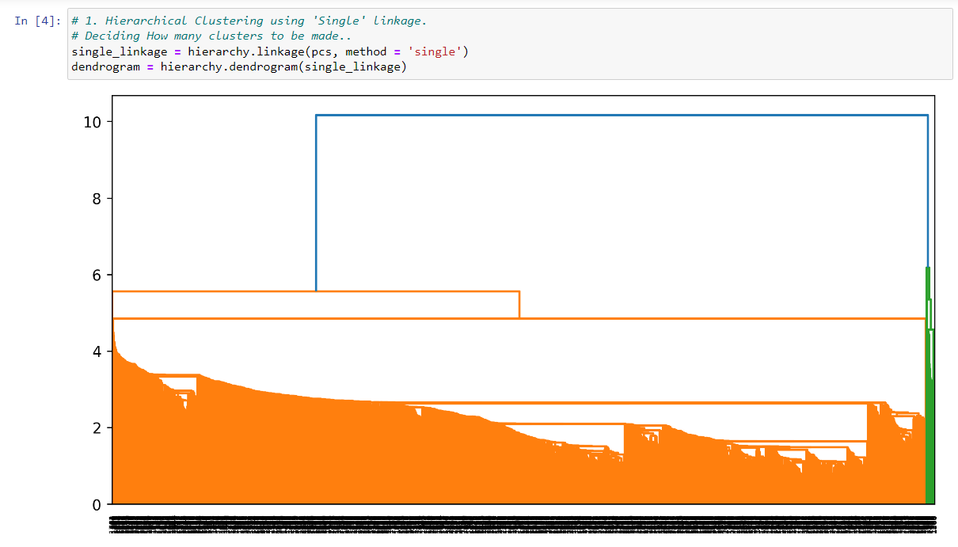
1. Hierarchical Clustering using Single Linkage Method.
Due to huge dataset the dendrogram is not interpretable
This cannot be a good approach to deal clustering on huge dataset.
We cannot rely on Hierarchical clustering using Single Linkage Method

Slide 26
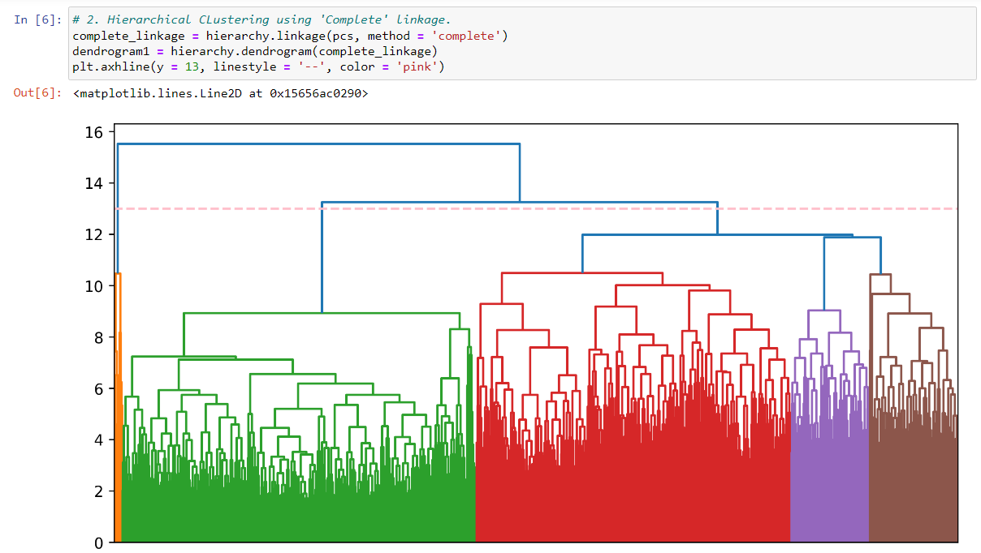
2. Hierarchical Clustering using Complete Linkage Method.
We can see the clusters are formed
We have maked horizontal cutting line to select the number of clusters to be formed.
But there is more jumbling of clusters and we can't decide the ideal no. clusters to form.
This could not be good approach for Clustering.

Slide 27
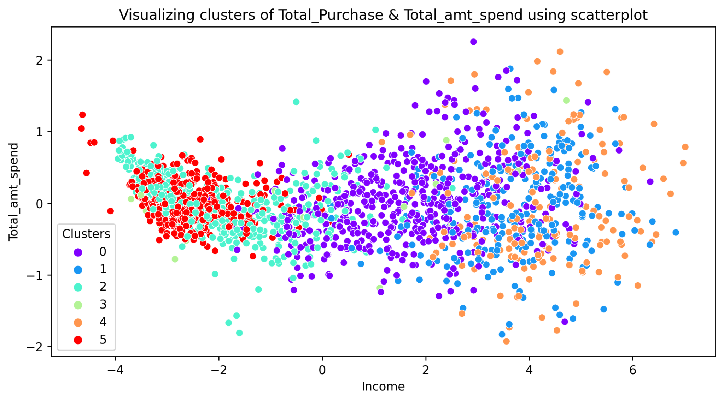
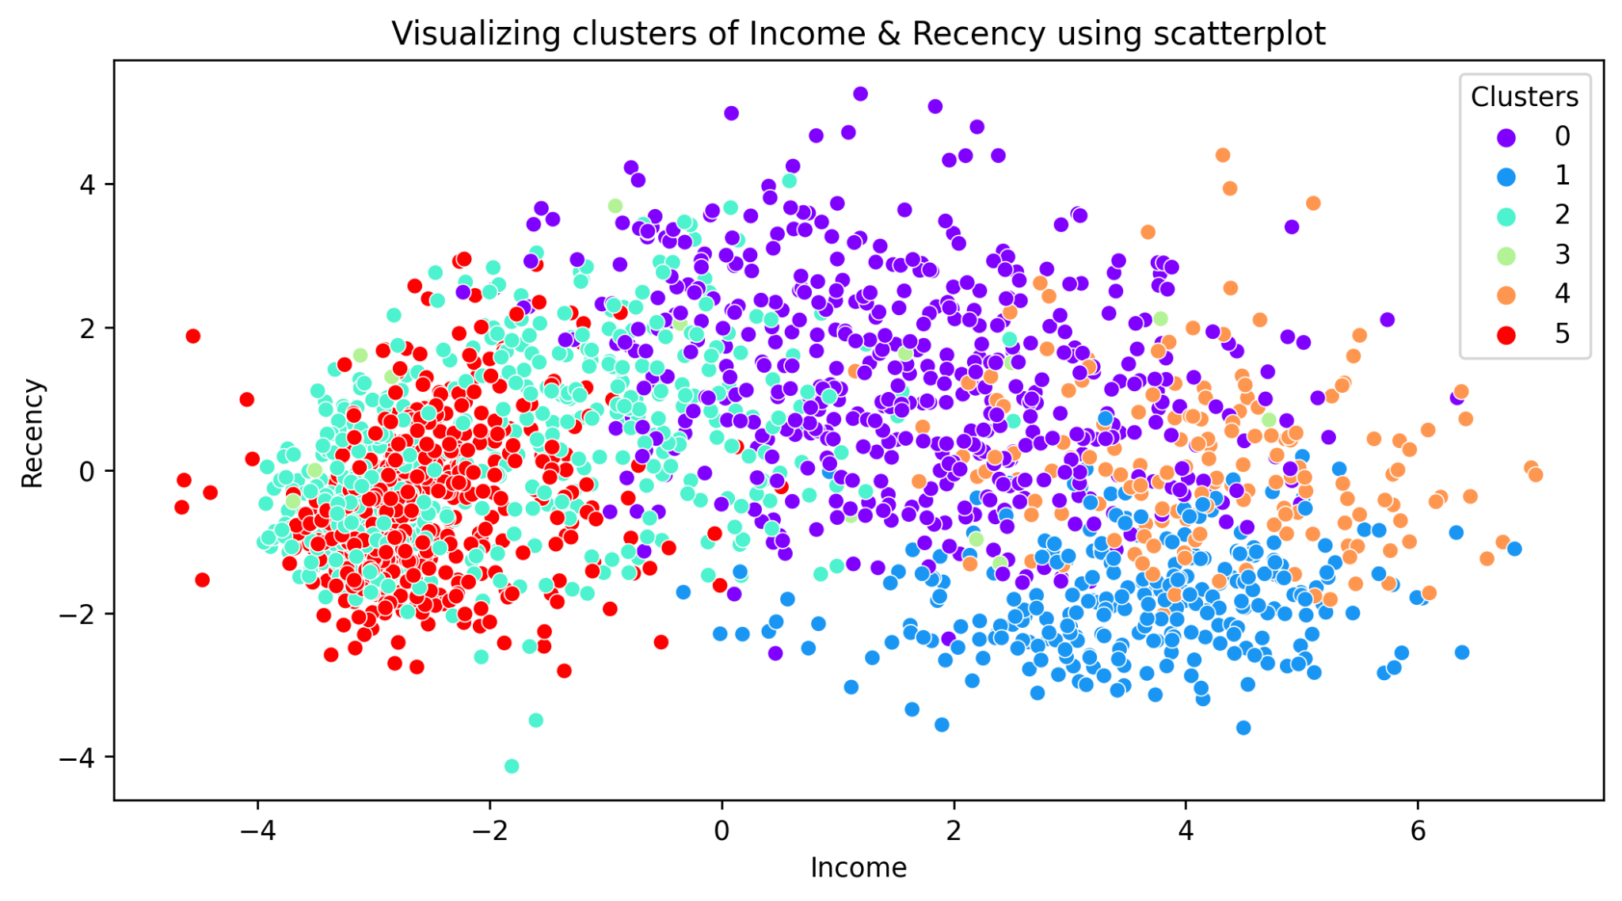
3.1. Agglomerative Clustering with n_clusters = 6
There is overlapping of clusters created and looks like 6 is not ideal no. of clusters to make.
We need to reduce number of clusters to reduce the overlapping of clusters.

Slide 28
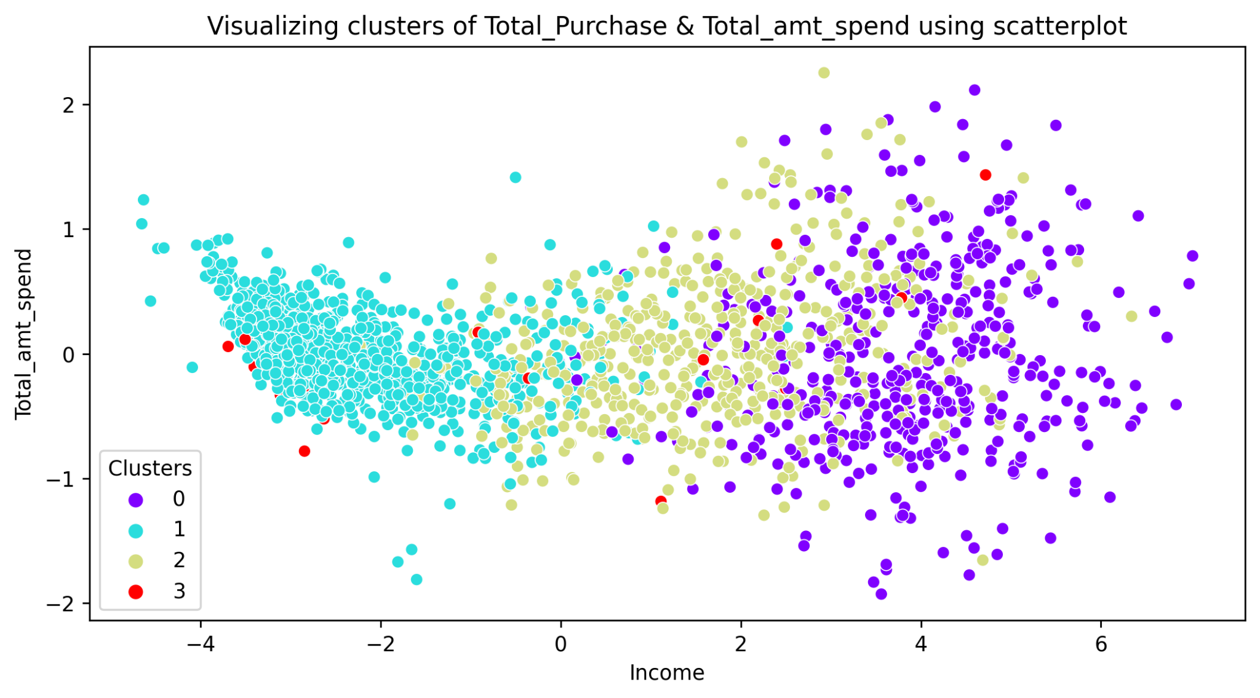
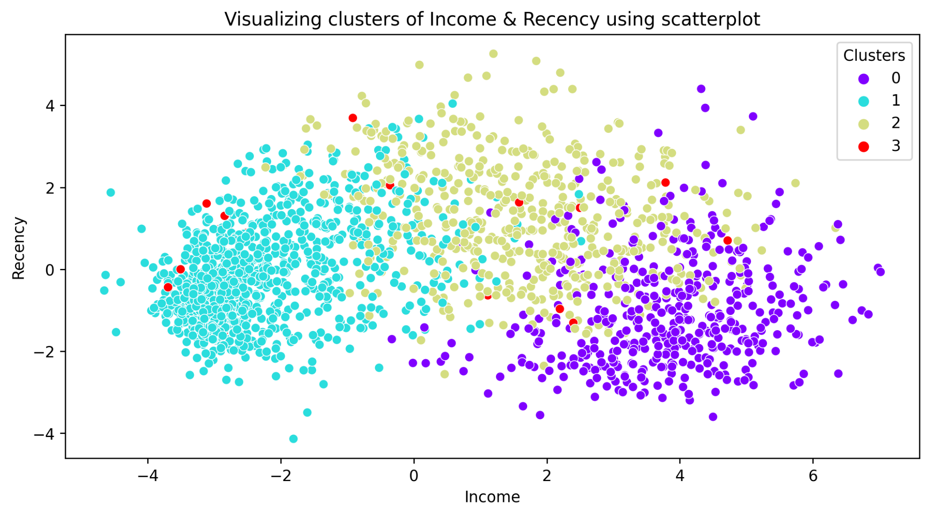
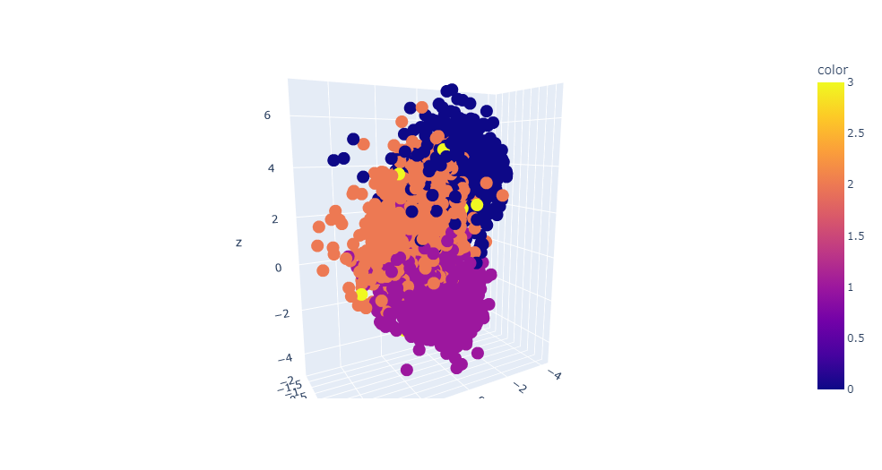
3.2. Agglomerative Clustering with n_clusters = 4
After reducing the number of cluster we can see it has created clusters effectively, but still it looks like 4 is not optimal numbers to be created.
It looks like 3 clusters can be optimal for this data.

Slide 29
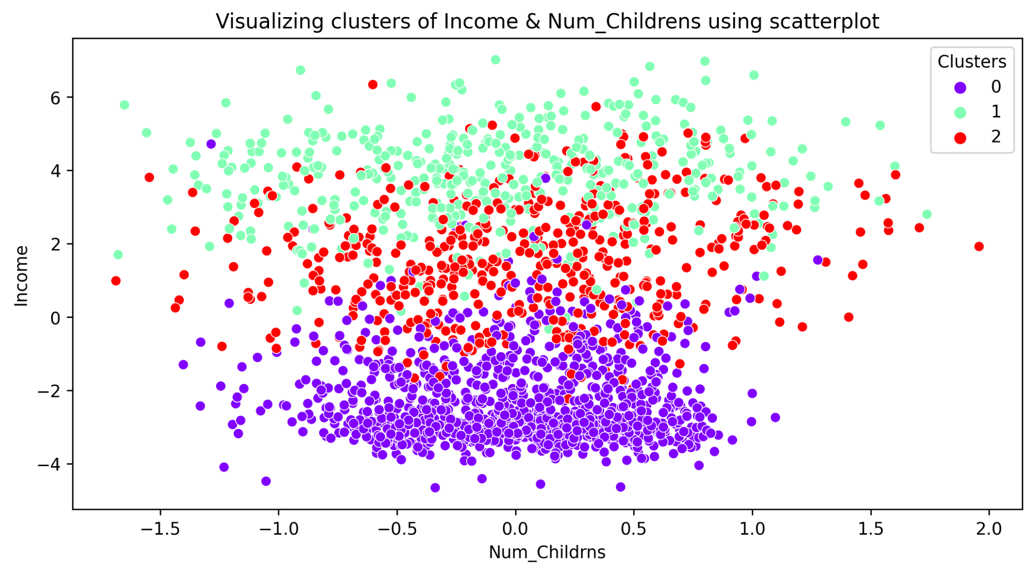
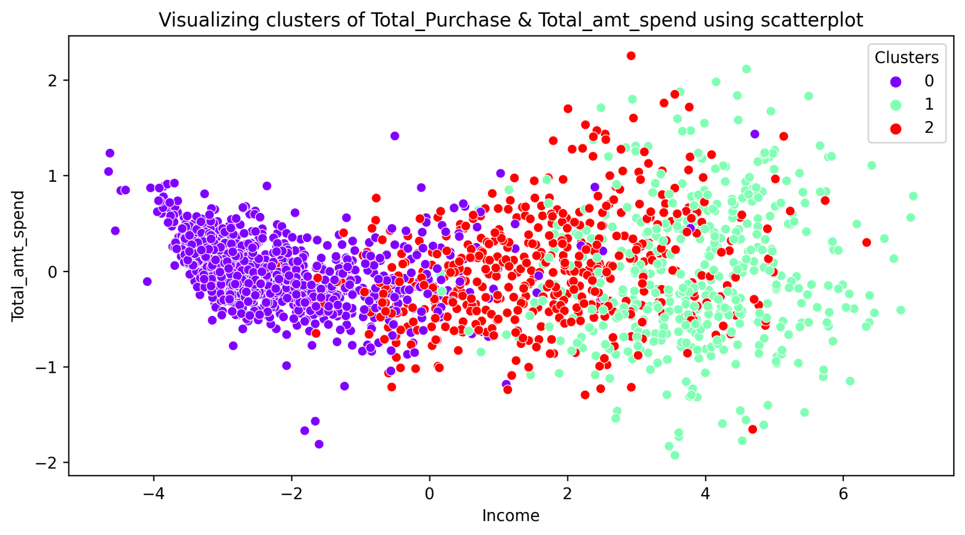
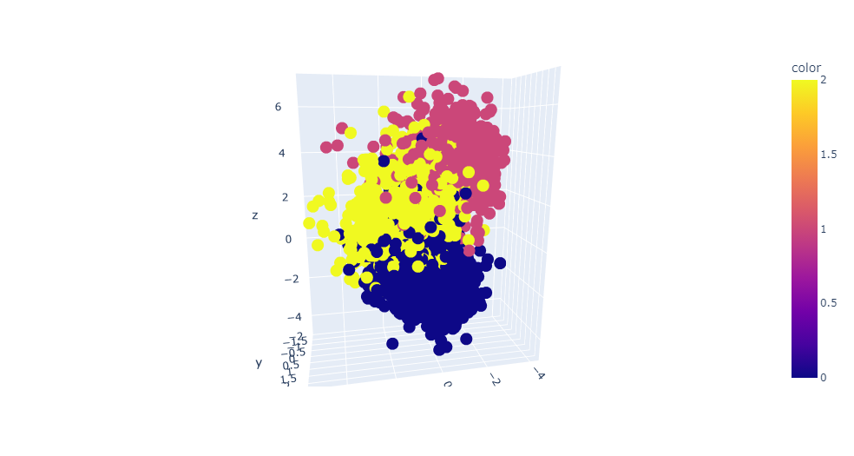
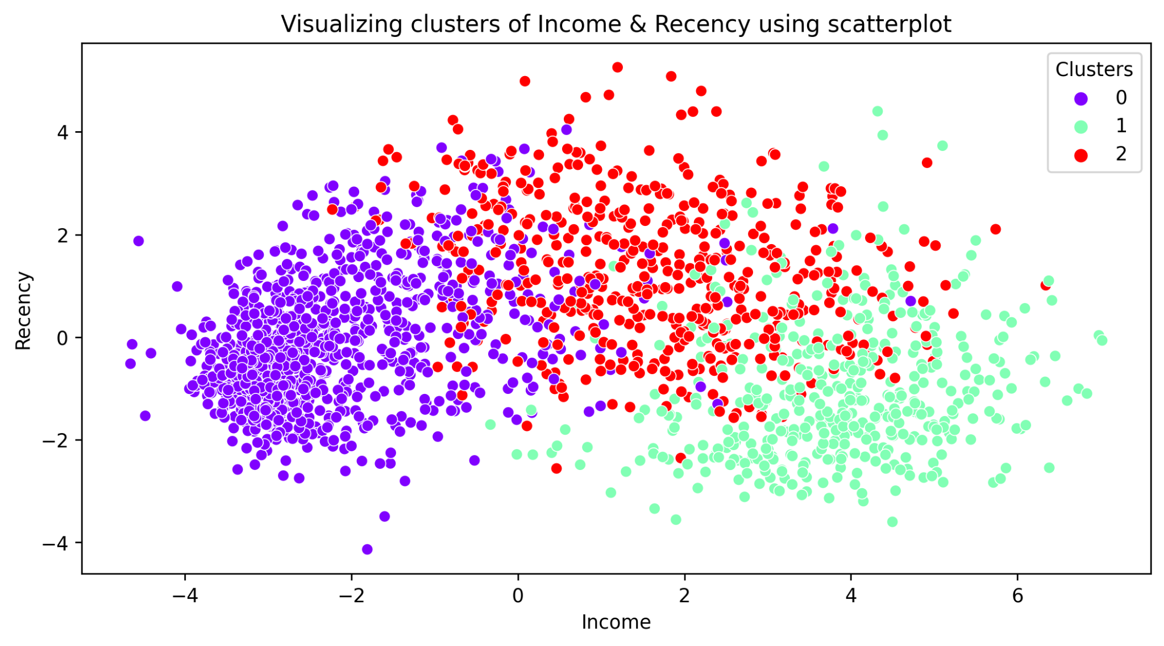
3.3. Agglomerative Clustering with n_clusters = 3

Slide 30
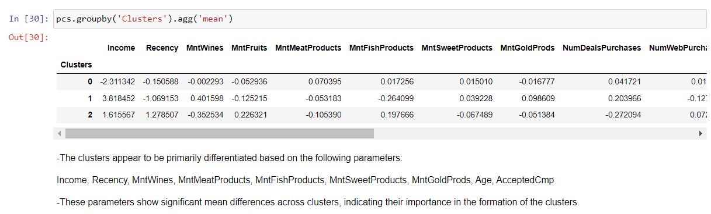
Analysis of Agglomerative Clustering (n_clusters = 3)
The clusters appear to be primarily differentiated based on the following parameters:
“Income, Recency, MntWines, MntMeatProducts, MntFishProducts, MntSweetProducts, MntGoldProds, Age, AcceptedCmp”.
These parameters show significant mean differences across clusters, indicating their importance in the formation of the clusters.
Here it looks like 3 clusters are okay to have

Slide 31
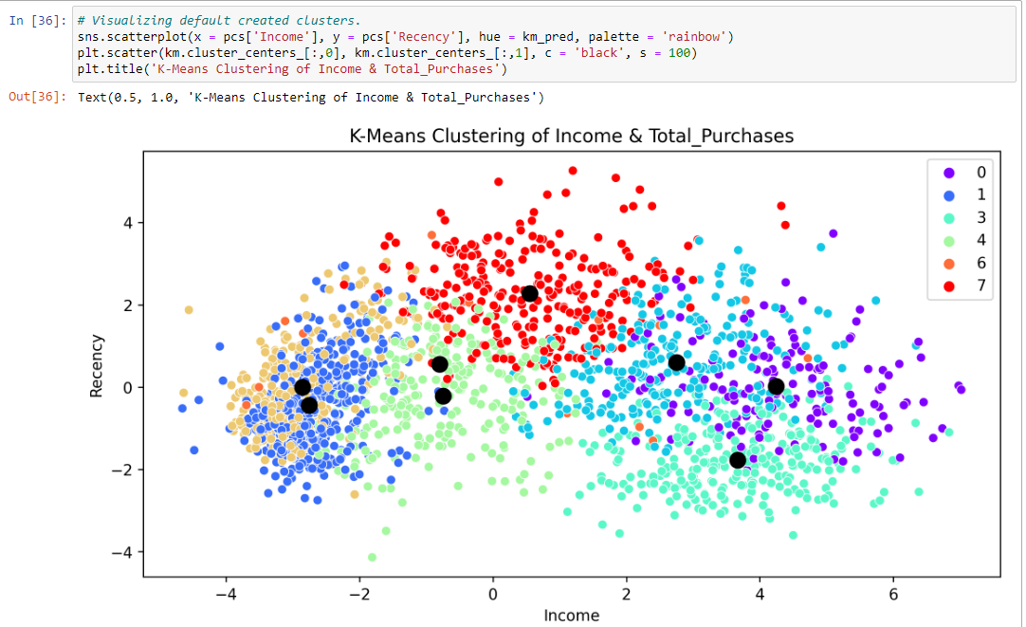
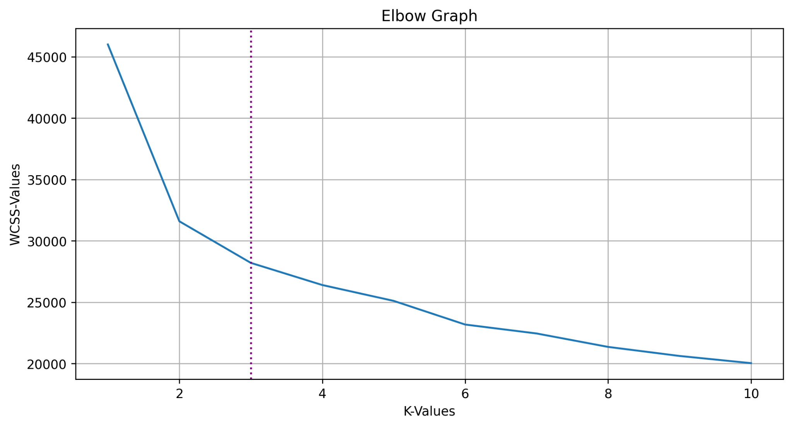
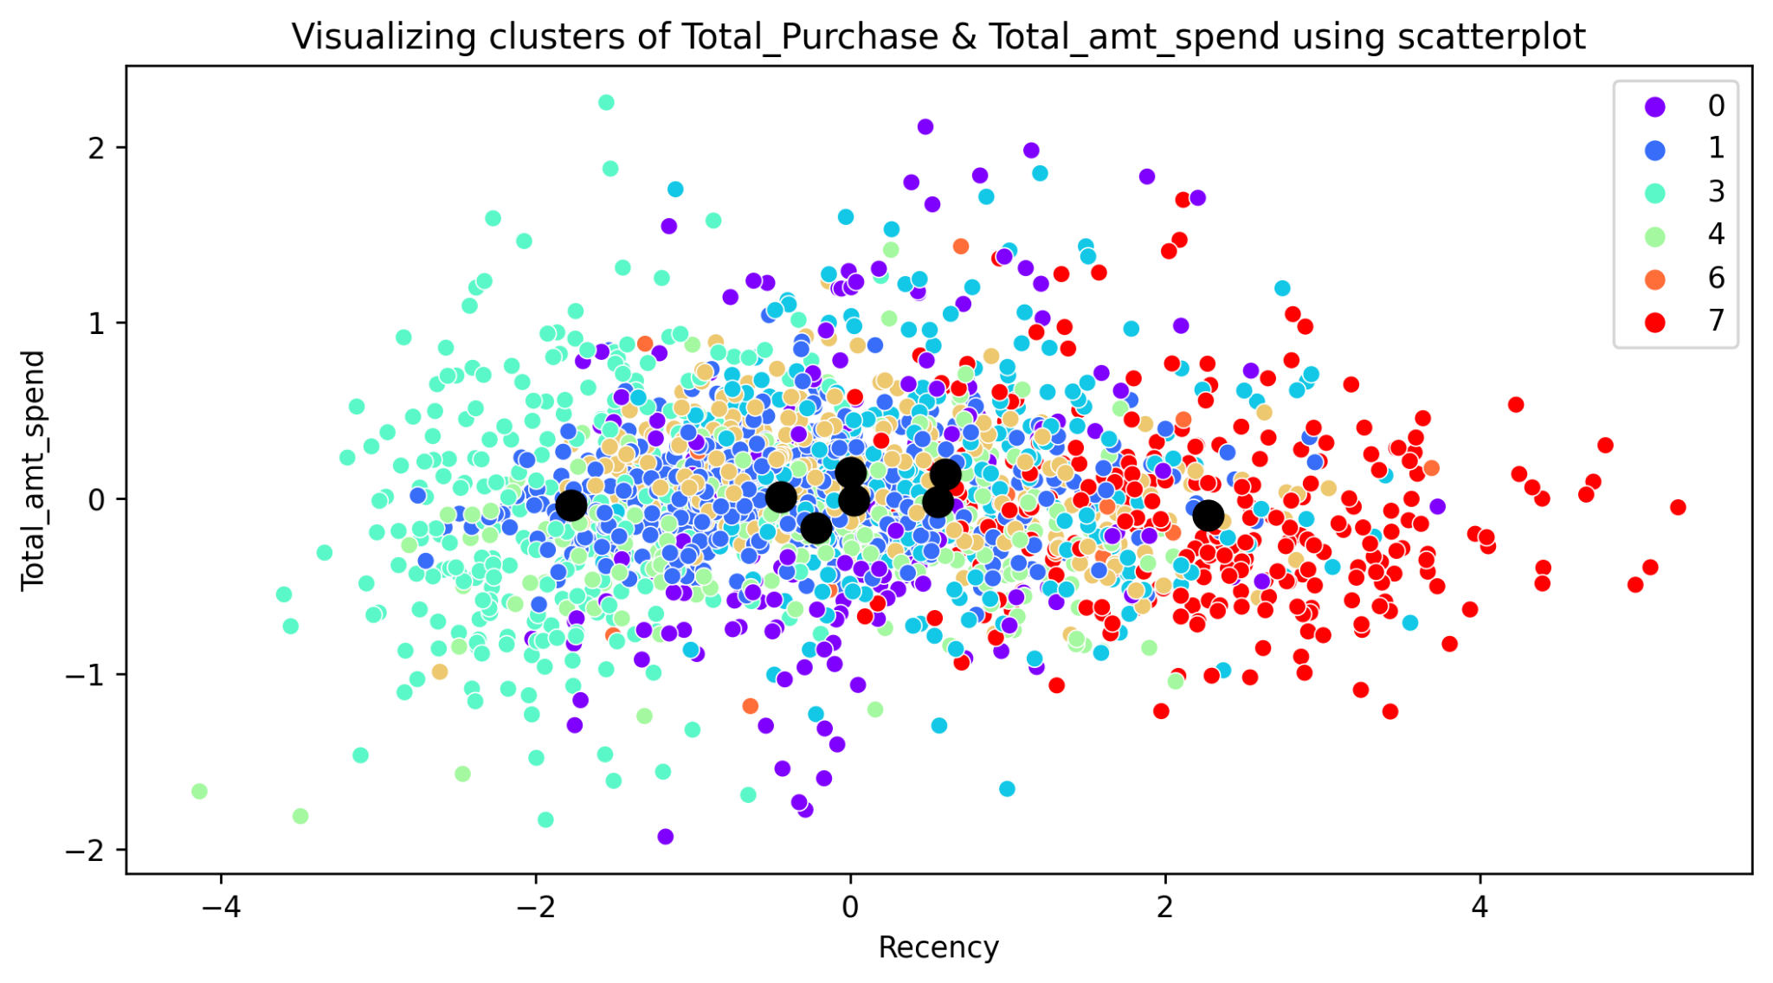
4.1. K-Means Clustering with default parameters
After applying K-Means Clustering Algorithm, it had created 8 clusters by default.
But for the dataset it looks like 8 is not the ideal number of clusters should be made.
We needed to plot WCSS (Elbow) graph to get ideal numbers of clusters and perform HyperParameter Tuning.
After checking Elbow Graph, we discovered 3 is the optimal numbers to be made.

Slide 32
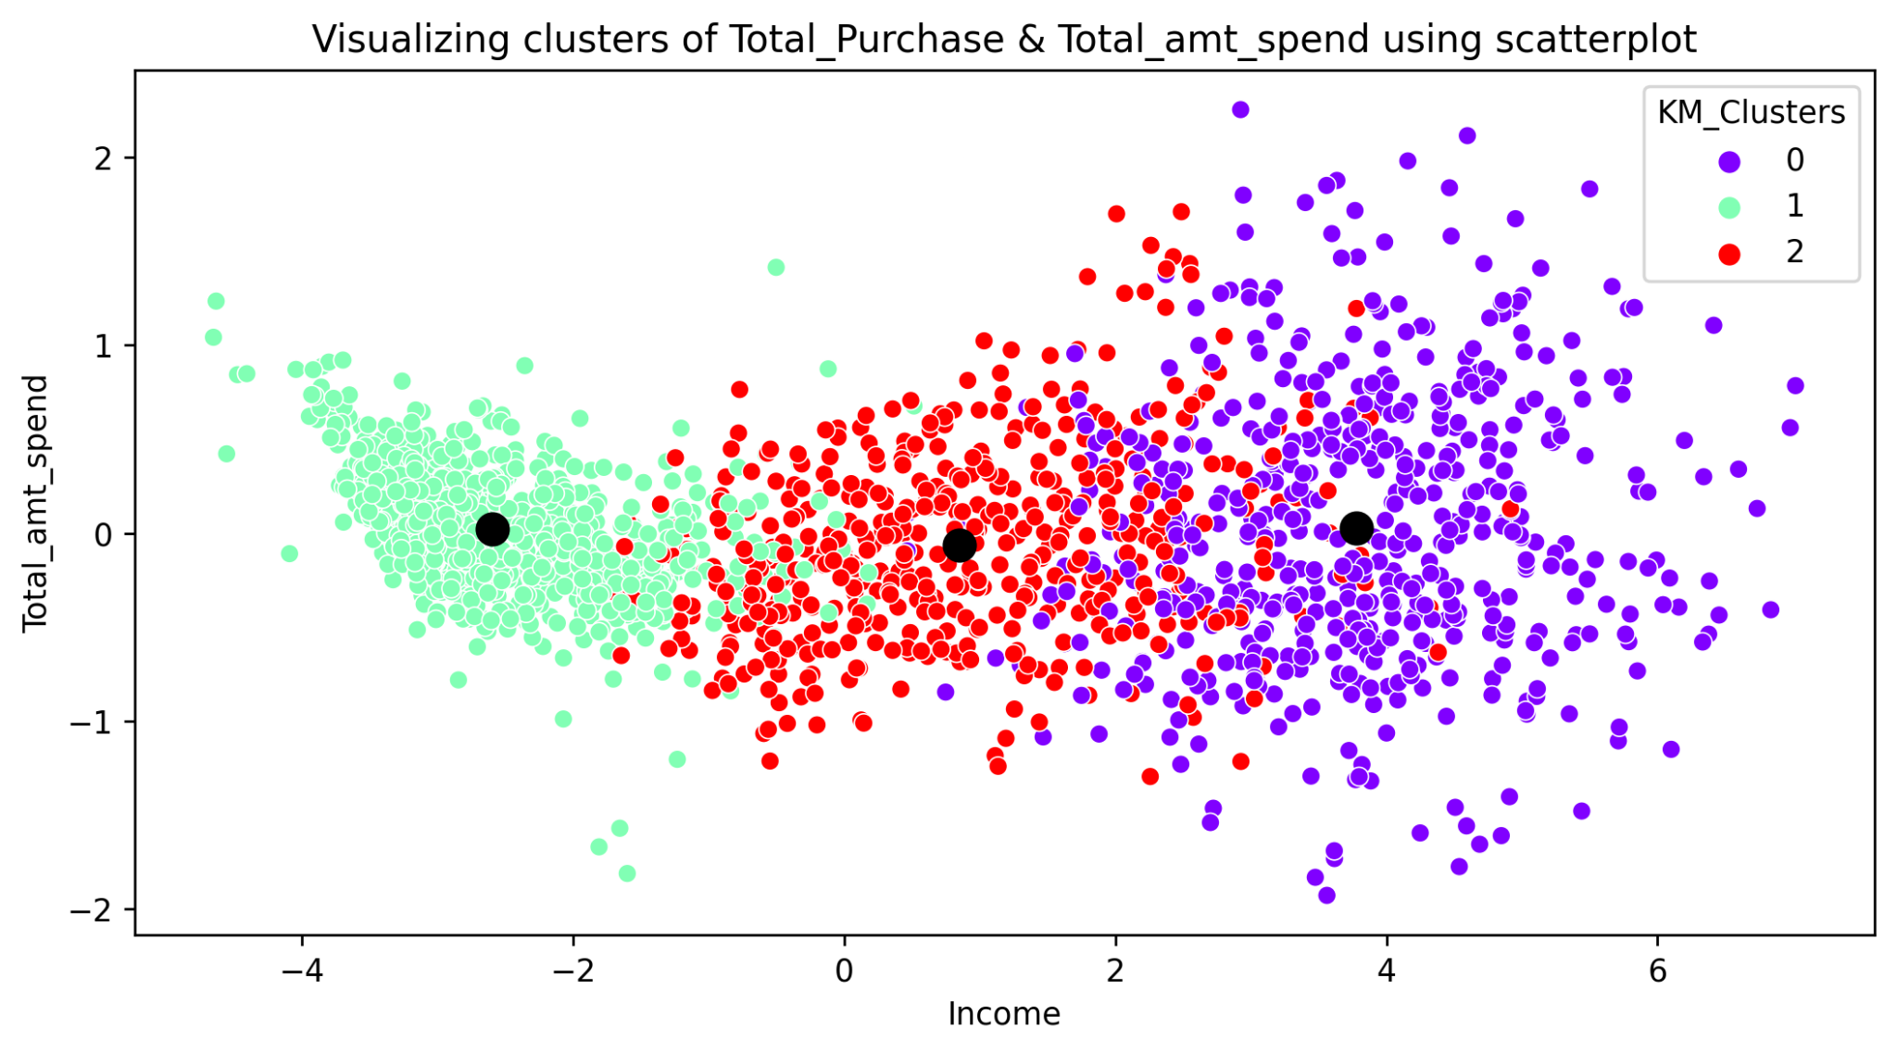
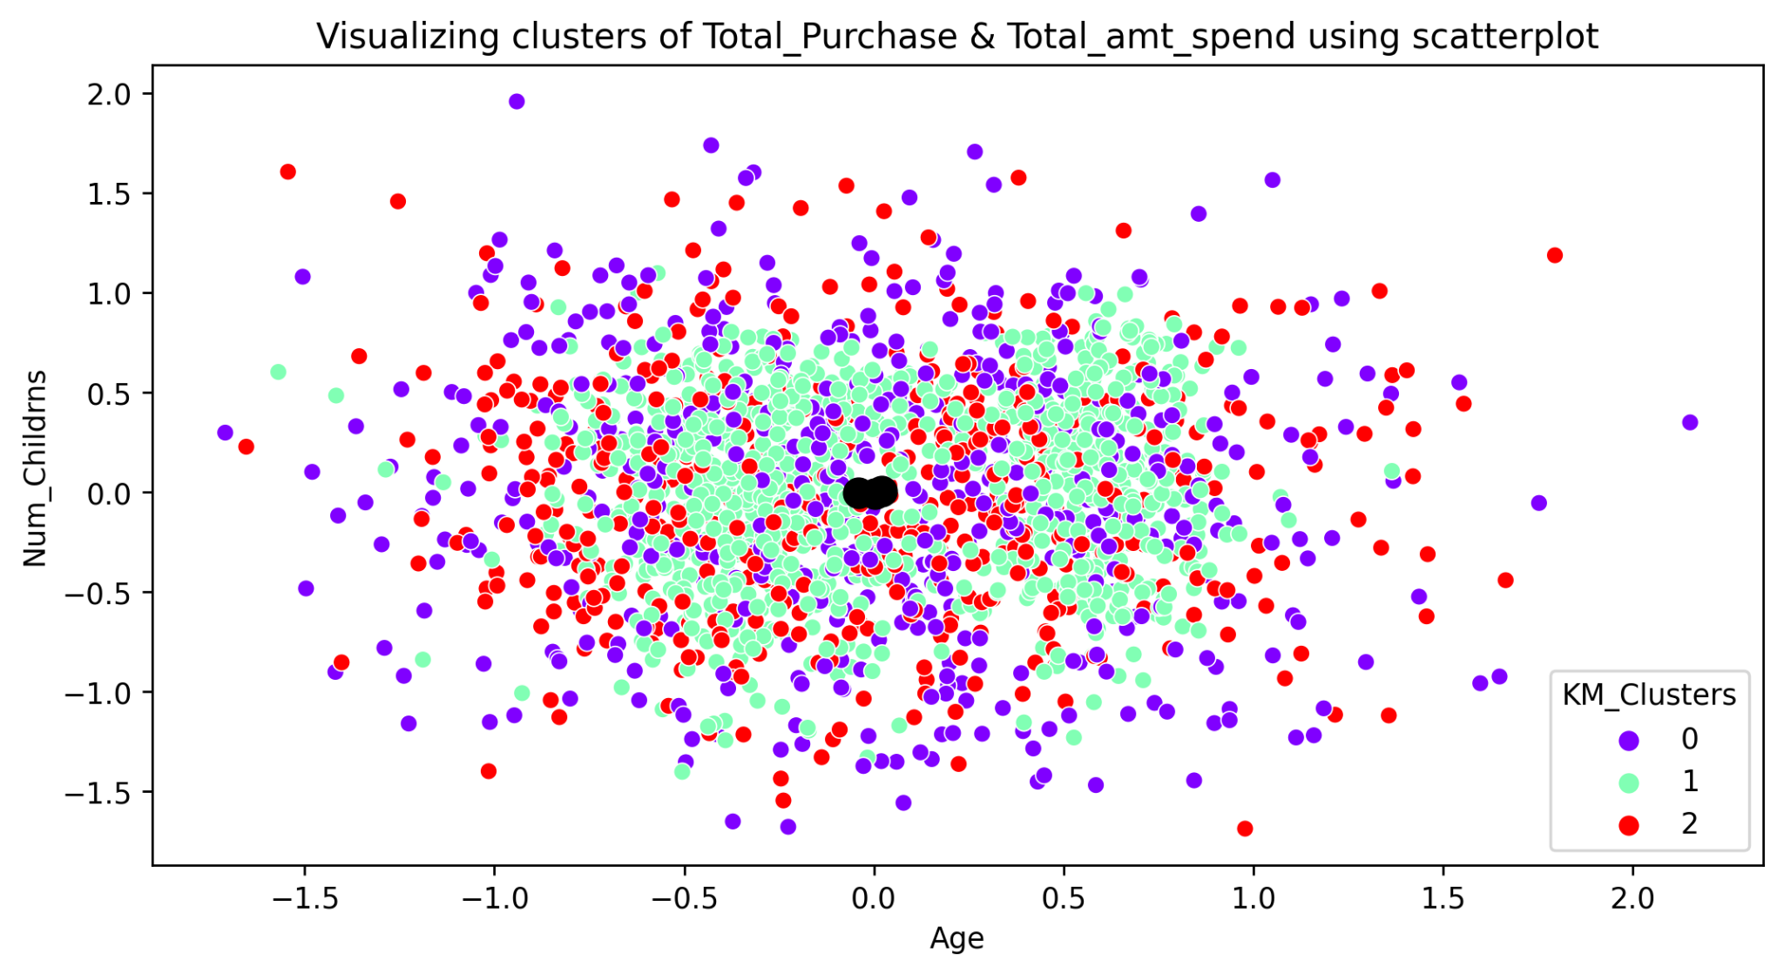
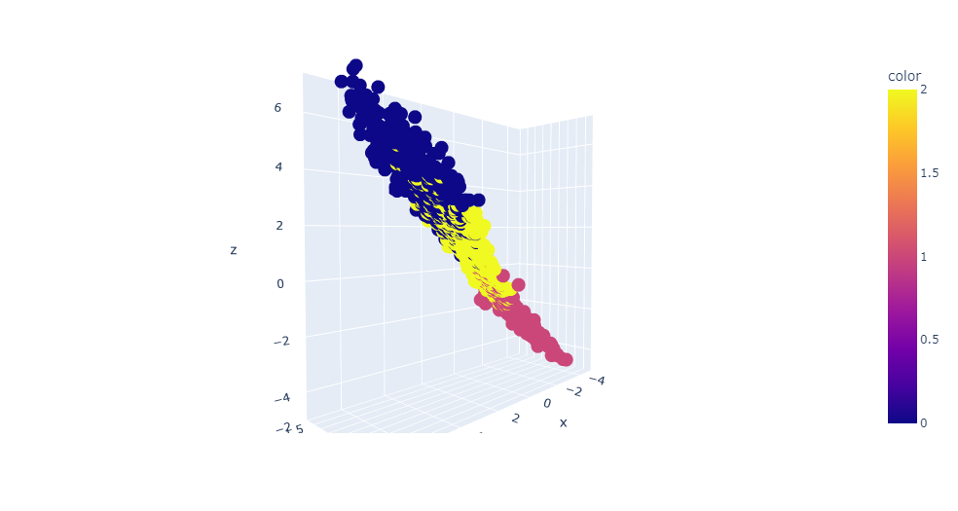
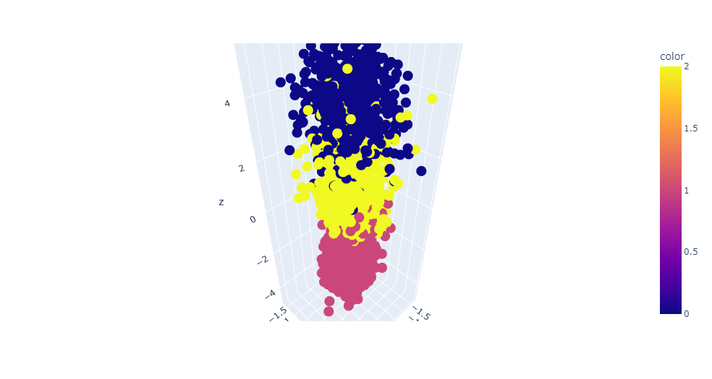
4.2. K-Means Clustering (Optimized Model)

Slide 33
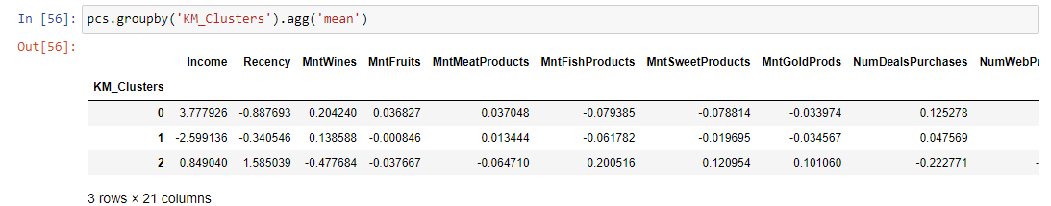
Analysis of K-Means Clustering (Optimized Model)
On what basis the clusters are made ?
Cluster 0:
High Income: Mean income is high (3.752135).
Low Recency: Customers in this cluster tend to have lower recency (-0.853104).
Moderate Spending: They have positive mean values for “MntWines, MntFruits, MntMeatProducts, MntGoldProds, and NumDealsPurchases“, indicating moderate spending in these categories.
Cluster 1:
Low Income: Mean income is significantly low (-2.605086).
Medium Recency: Recency is closer to zero (-0.351925), indicating average recency.
Mixed Spending: They have mixed spending habits with some positive and some negative mean values across different product categories.
Cluster 2:
Moderate Income: Mean income is moderate (0.785852).
High Recency: High positive recency (1.607756), indicating customers are more recent.
Lower Spending: They have negative mean values for MntWines, MntFruits, MntMeatProducts, indicating lower spending in these categories, but positive values for MntFishProducts and MntSweetProducts.

Slide 34
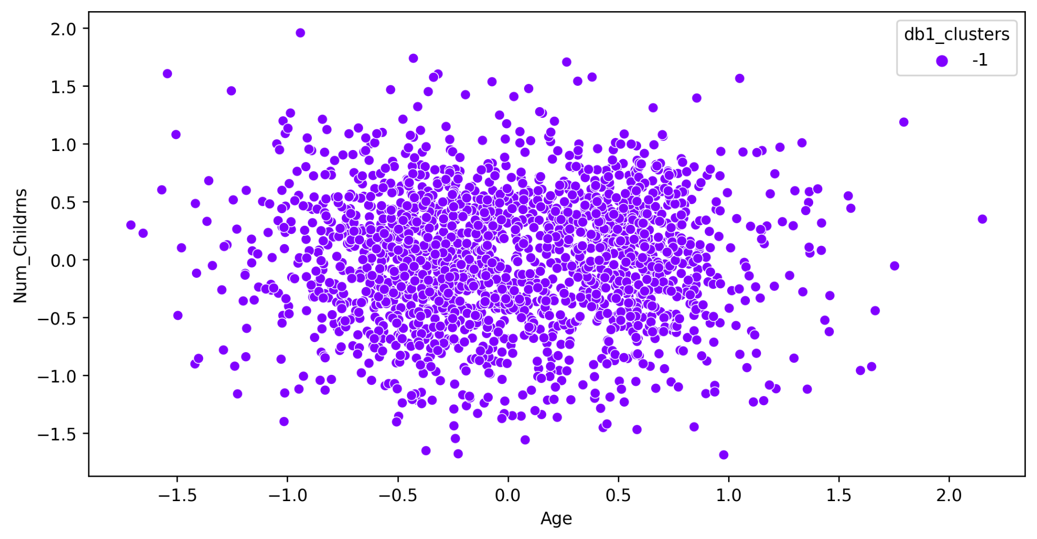
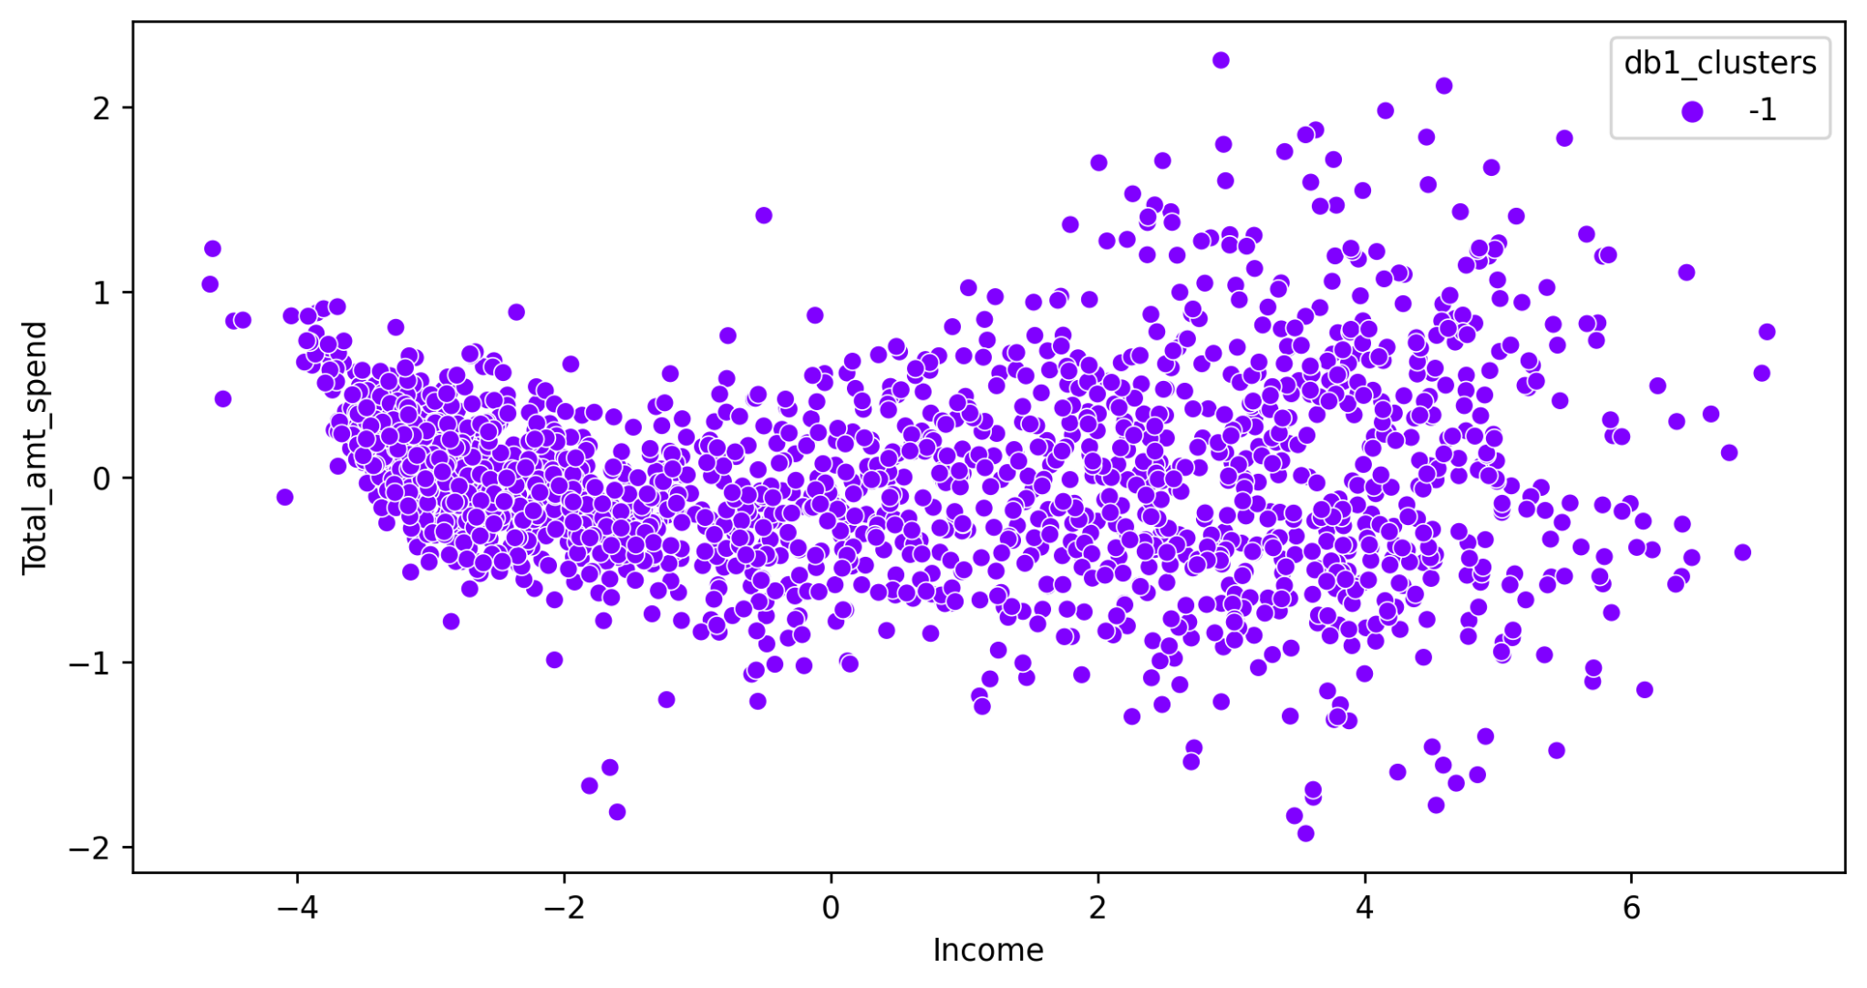
5.1. DBSCAN Clustering with (Default Parameters)
DBSCAN basic model has created only 1 cluster for dataset with epsilon value 0.5 and min_samples as 3
But the -1 cluster represented as noise.
It means all the data points are considered as noisy data according to Basic DBSCAN model.
So we needed to perform HyperParameter Tuning to create clusters using DBSCAN algorithm.

Slide 35
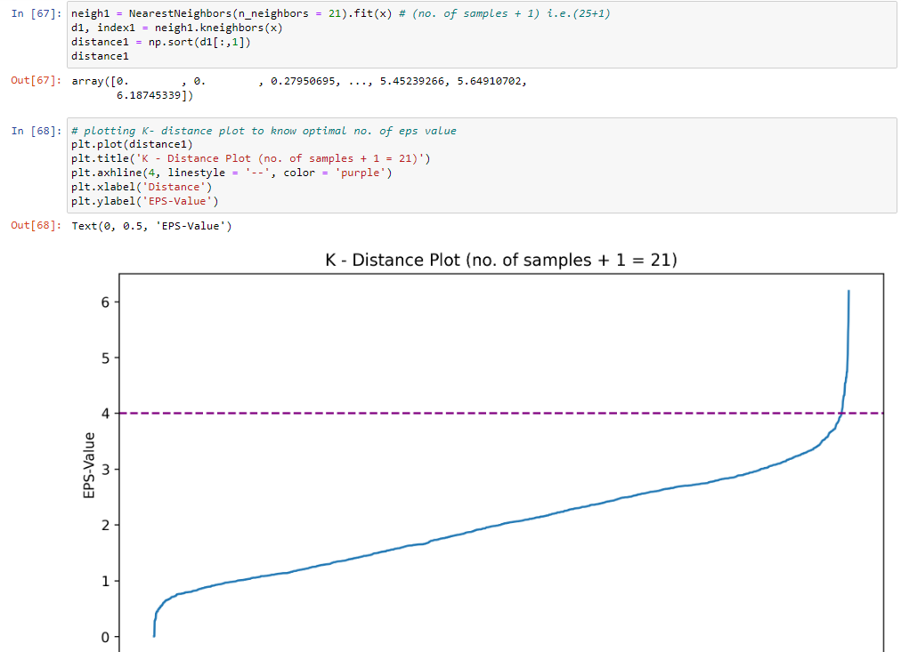
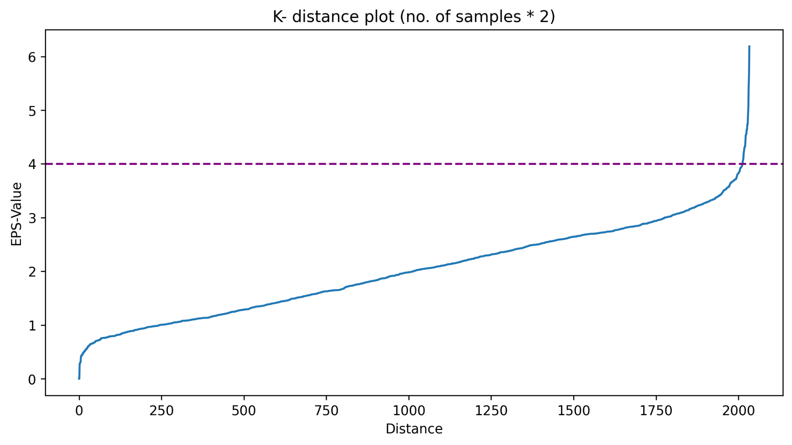
HyperParameter Tuning of default DBSCAN Model
After making changes in NearestNeighbors(n_neighbors = ()) we plotted K-Distance Plot.
By plotting it found that 4 is the ideal eps value where we can see the change in slope of line.
We needed to tune eps value while creating Optimized DBSCAN model.

Slide 36
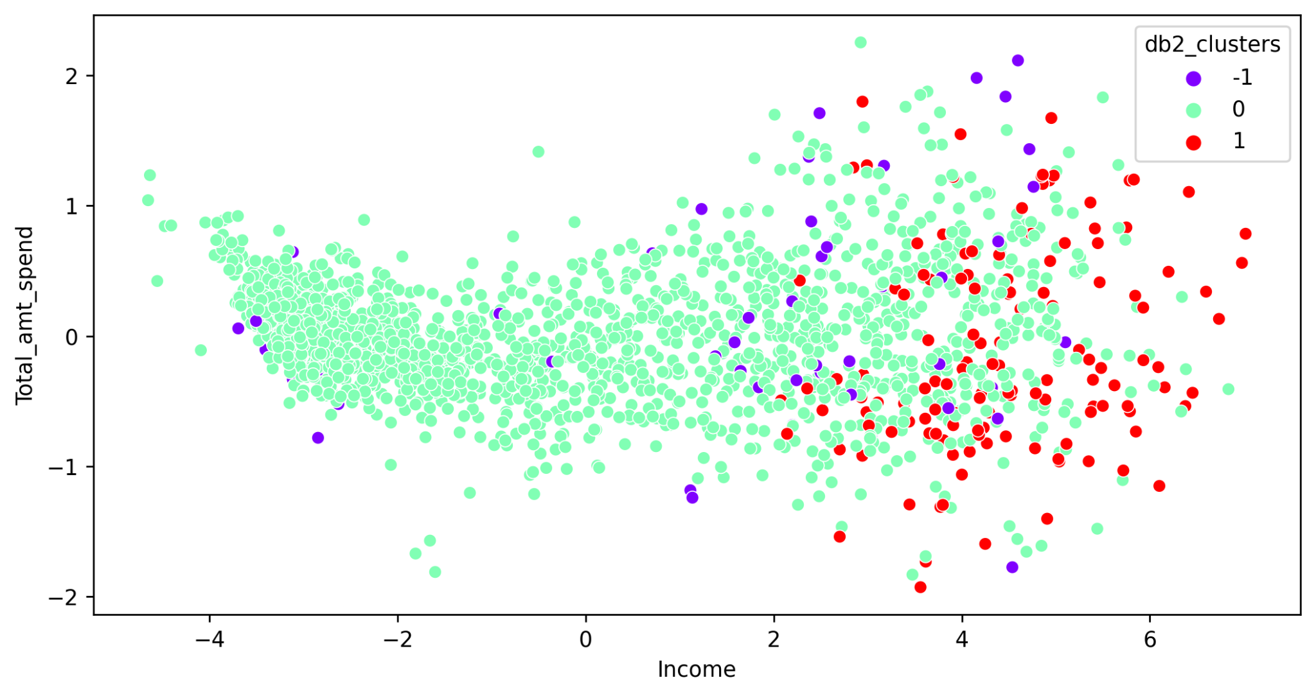
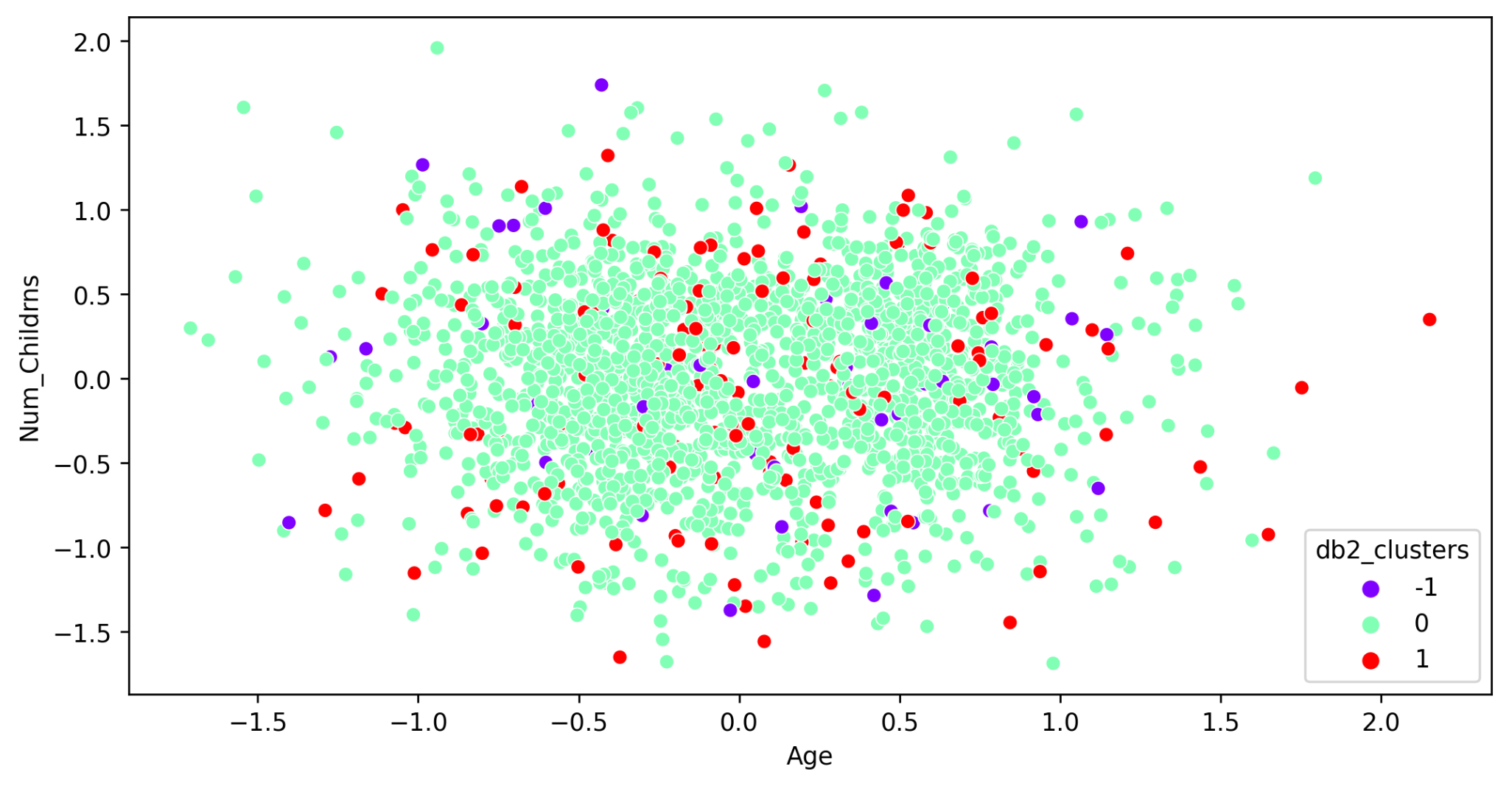
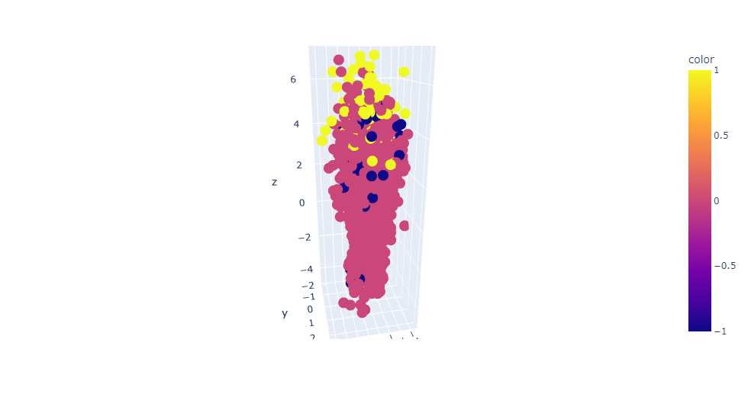
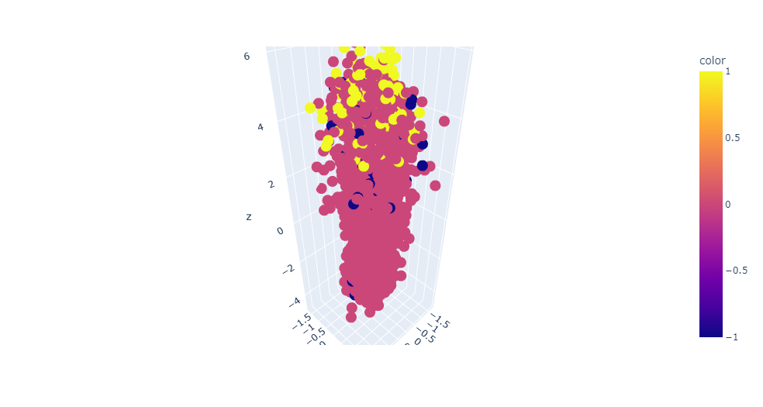
5.2. DBSCAN Clustering (Optimized Model)

Slide 37
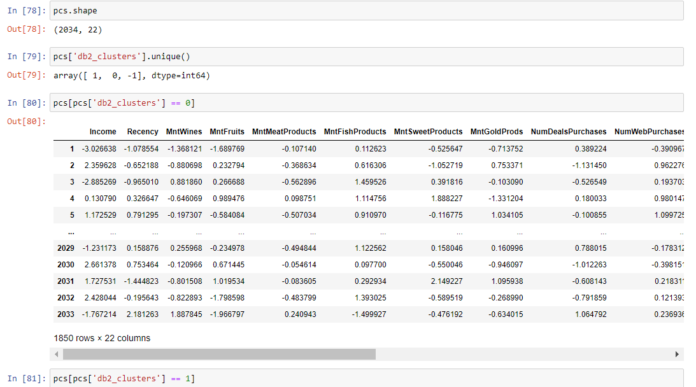
Analysis of DBSCAN Clustering (Optimized Model)
After tuning DBSCAN model it has created 3 clusters.
Cluster 0 has 1850 data points.
Cluster 1 has 133 records.
Cluster -1 has 51 records.
But we can’t use this data for creating final predictive model due to unbalanced data.
Model can only be trained on unbalanced data.

Slide 38

Selecting Best Clustering Model -
Model Evaluation -
Here we can see Final DBSCAN model has given highest accuracy as compared to other algorithms.
But after visualizing the clusters we can see there is overlapping of clusters and they are not formed precisely and effectively.
As we saw before, clusters formed using optimized K-Means algorithm were giving excellent distributions of clusters.
So selecting Optimized K-Means model as final clustering model for clustering.
Saved the data frame (Features) along with the predicted clusters (Labels).

Slide 39


Model Deployment -
1. Creation of Pipeline -
Imported Necessary Libraries.
Loaded dataset.
Defined Features and K-Means predicted clusters as labels.
Splitted data into Training and Testing sets.
Fitted a simple Logistic Regression model.
Checked model Performance using Classification Report and Confusion Matrix.
Applied Data Transformation Steps to be taken on User Defined values such as Standardization, Encoding, splitting data into Training and Testing sets, Fitting classification model(Logistic regression) to classify new customer into appropriate cluster of customers.
Saved the pipeline model using Pickle library.

Slide 40

2. Deployment of Model using Streamlit -
Created a Python file to run the model as a WebApp.
Loaded the pipeline model and created a function to predict the classification.
Designed the UI (User Interface) of webapp using streamlit functions to get proper inputs from customer.

Slide 41


3. WebApp Interface 💻-

Slide 42
Challenges Faced -
Cleaning the data without losing any necessary information.
Visualizing the high dimension data into 2D or 3D plots / charts.
Applying appropriate Clustering Algorithms and evaluate their performances.
Selecting the best fitting Clustering Algorithm matching the need of solving the actual problem statement given.
Trying the best fitting Classification Algorithms to predict the cluster of new customer he belongs to.
Tuning the hyperparameters of model to get best training and testing accuracies.
Creating a pipeline for created model to pass the user provided data for transformation and prediction was the most challenging step among all.

Slide 43
Potential Solutions -
Reduced the higher dimension data into lower using PCA (Black Box Algorithm) technique.
Visualized the high dimension data using python libraries like matplotlib, seaborn and plotly by plotting 2D plots and 3d Scatterplots.
Evaluated the Clustering models performance using performance metrics like Silhouette Score.
Tried various classification algorithms such as Logistic Regression, Gradient Boosting, Random Forest, Naive Bayes, Support Vector Classifier and more and selected best out of them.
Evaluated Classification models based on their classification report, confusion matrix, training and testing accuracies.
Created pipeline for model to get user defined values and apply transformation techniques on new data.

Slide 44
Thank You..

